Slide 1
XRD Plots

Slide 2
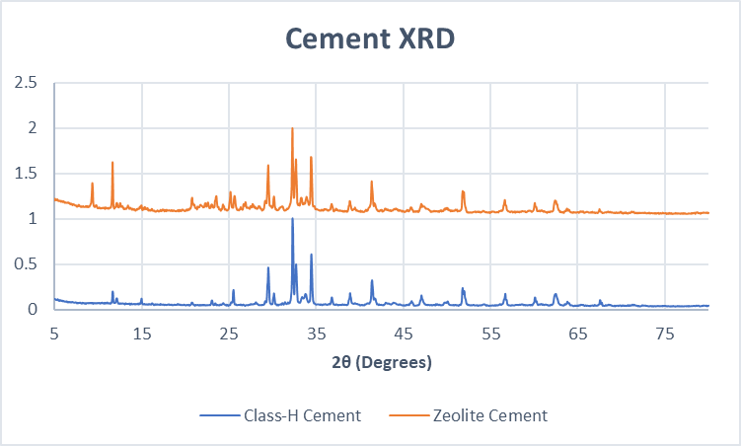
Cement XRD (Class-H and Zeolite)

Slide 3
XRD of as received Ferrierite

Slide 4
XRD of as Received Mordenite

