Slide 1
Indentation of Graphene Cement

Slide 2
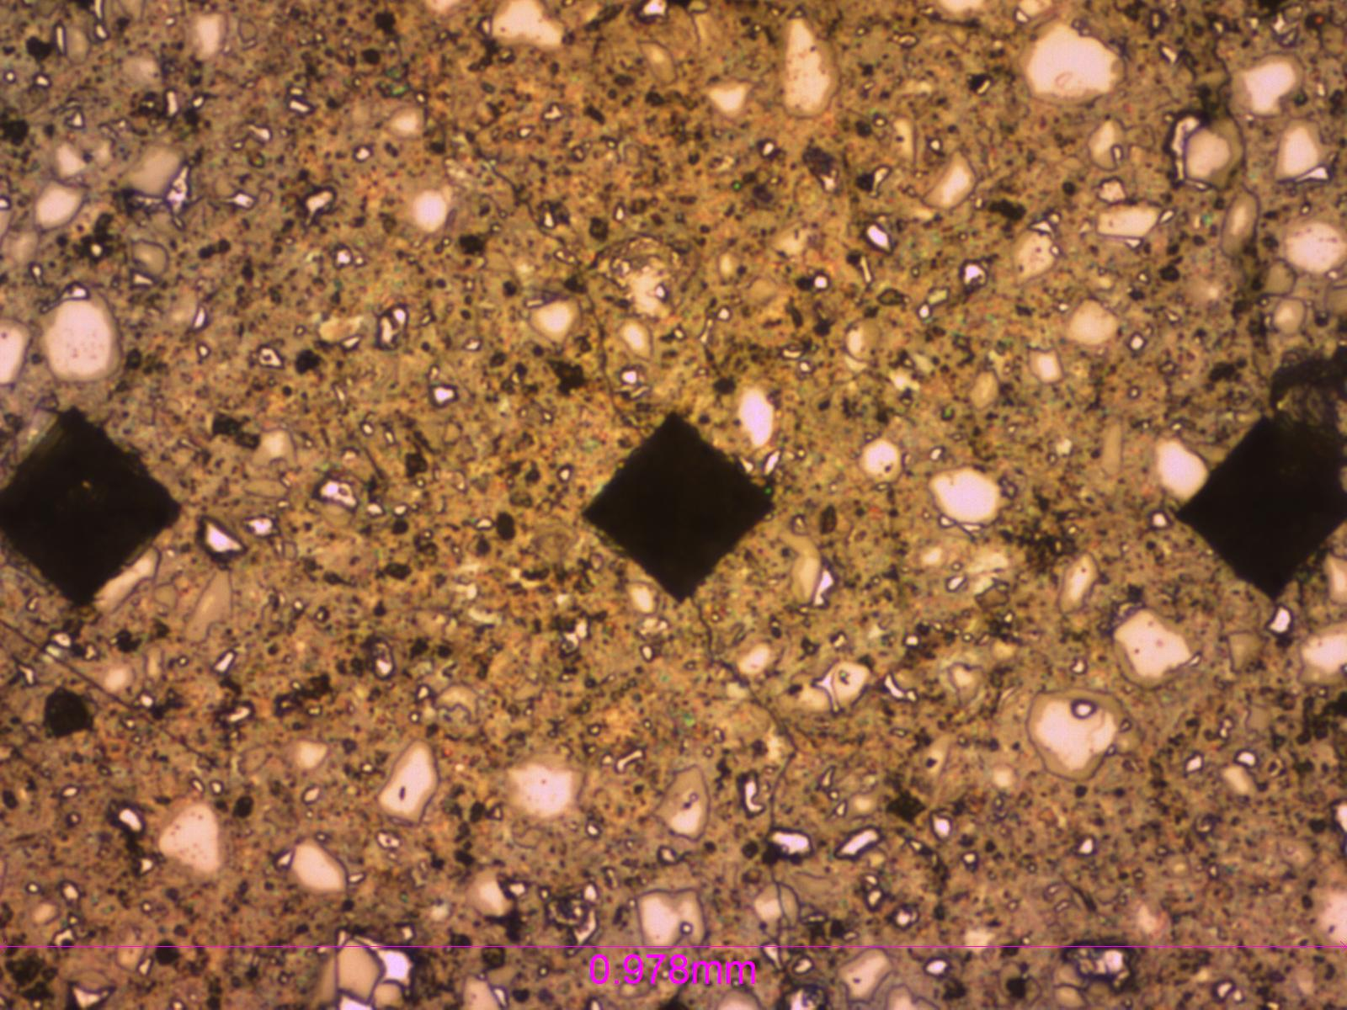
Vicker’s Micro indentation
Micro indentation conducted on polished cement samples of Neat, 0.05%, and 0.1%bwoc graphene addition. Both 0.05% and 0.1% exhibit reduction of elastic modulus indicating increased ductility of the cement.

