Slide 1
GNP -Cement
BSE EDS Indentation and Mineralogy

Slide 2
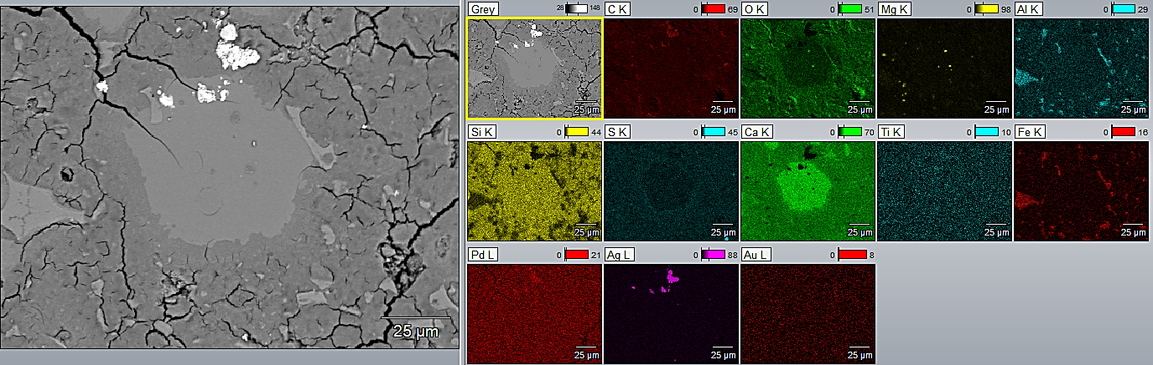

Slide 3
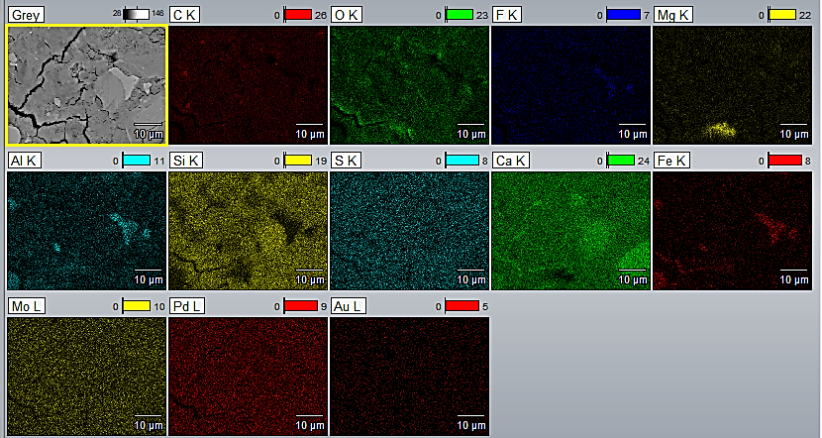

Slide 4
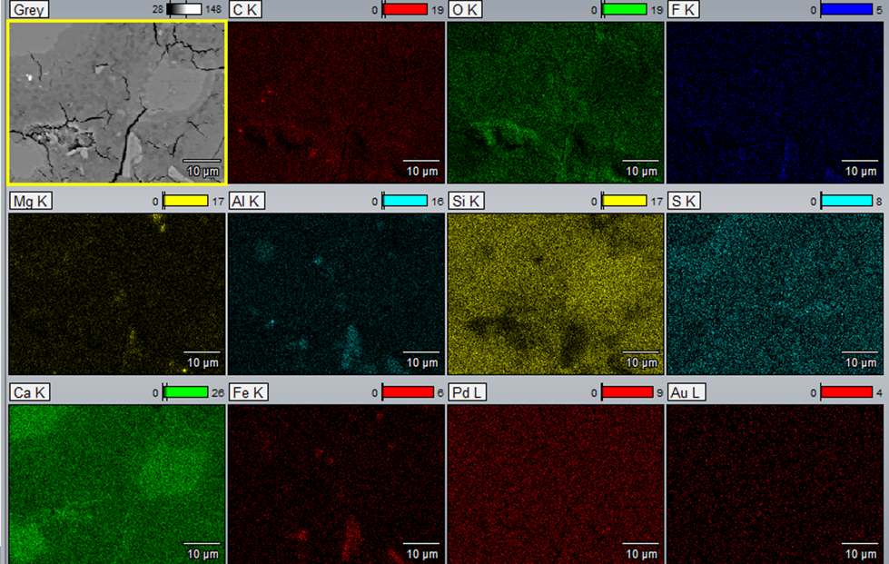

Slide 5
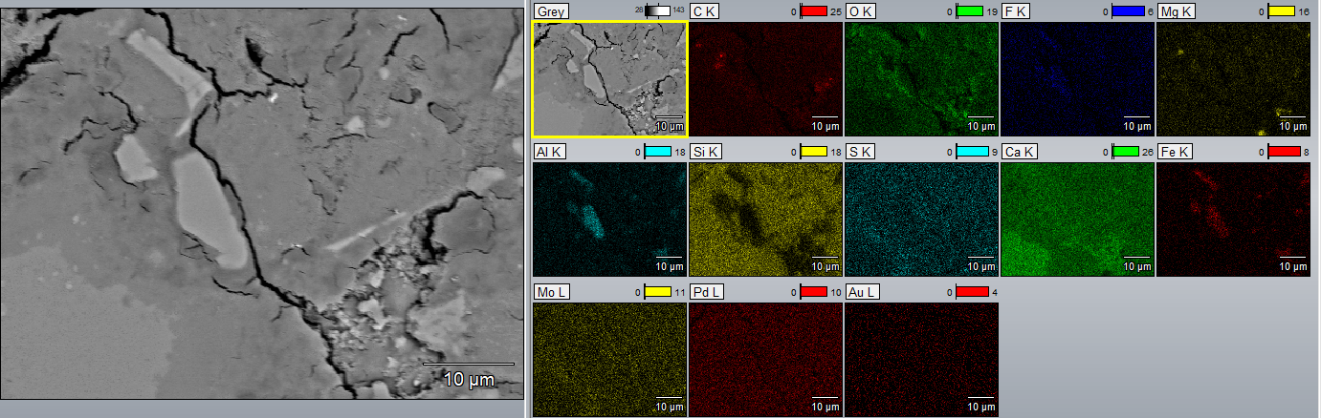

Slide 6
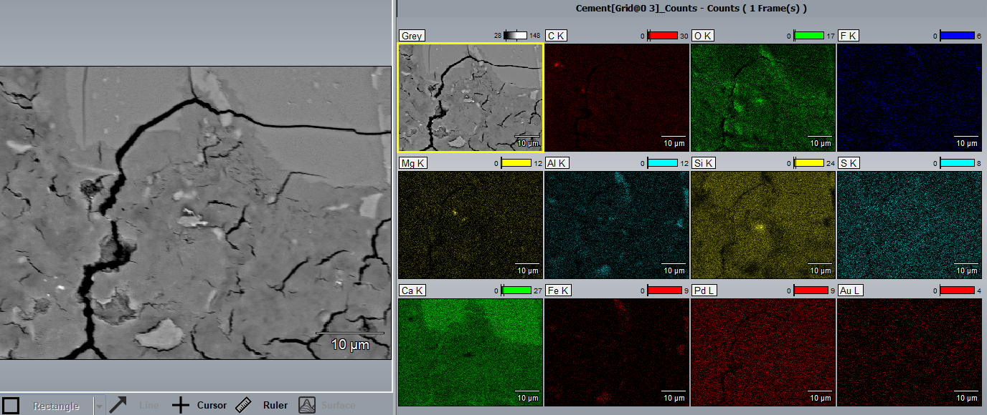

Slide 7
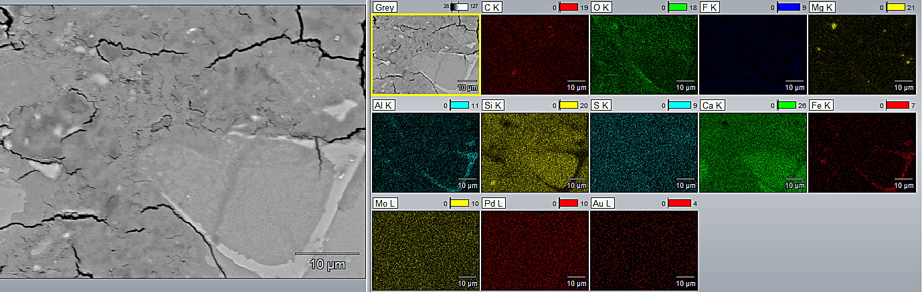

Slide 8
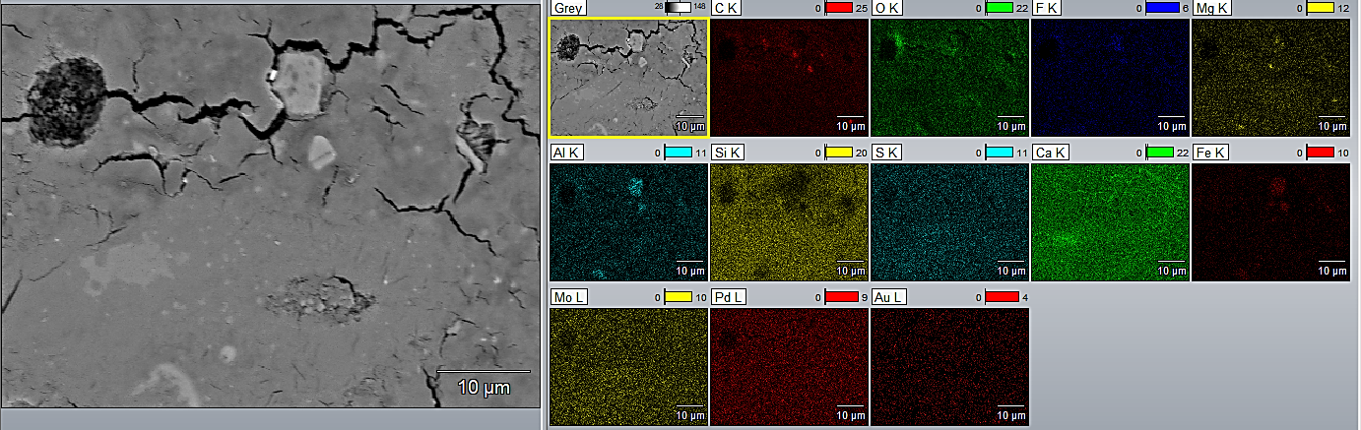

Slide 9
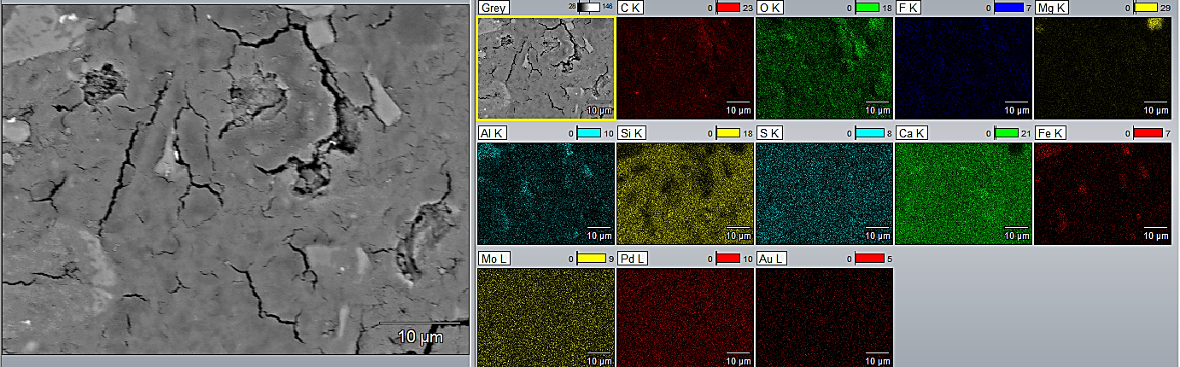

Slide 10
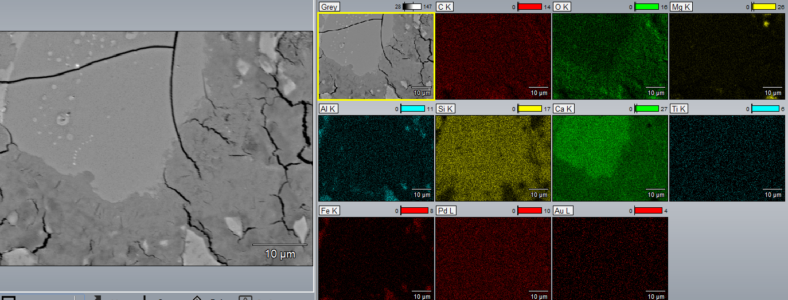

Slide 11
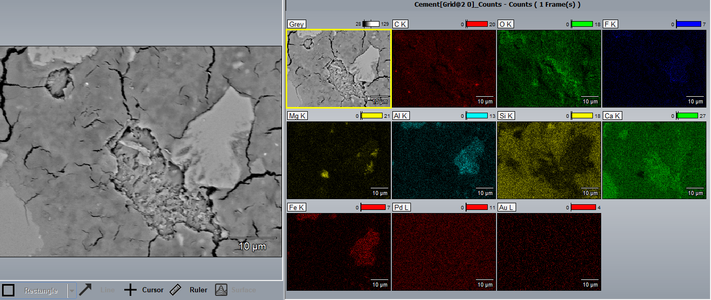

Slide 12
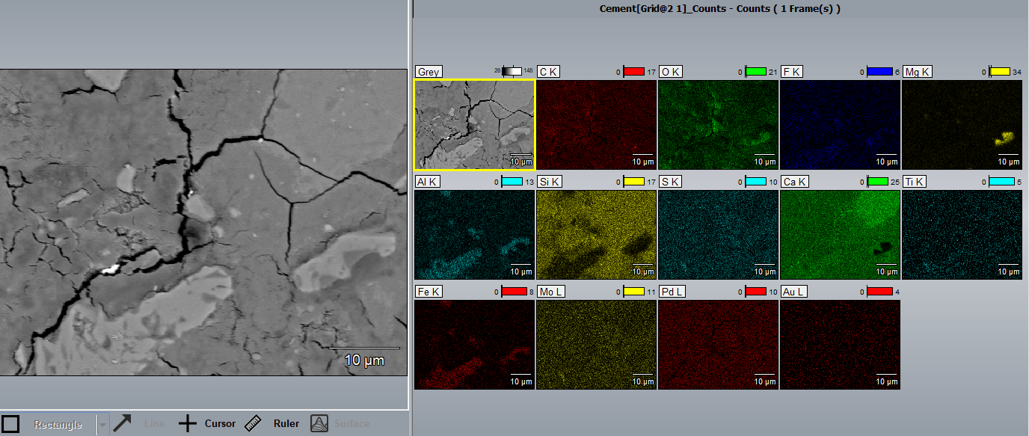

Slide 13
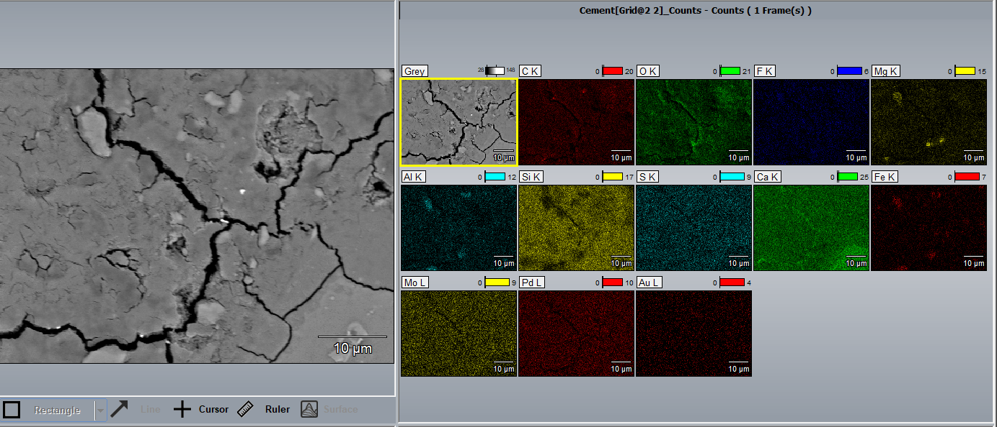

Slide 14
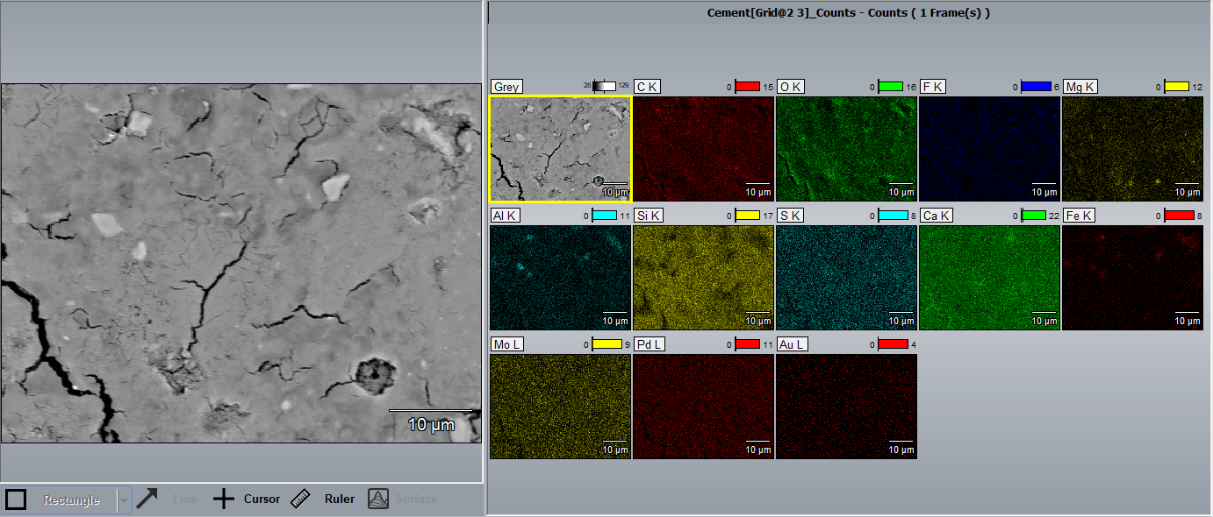

Slide 15
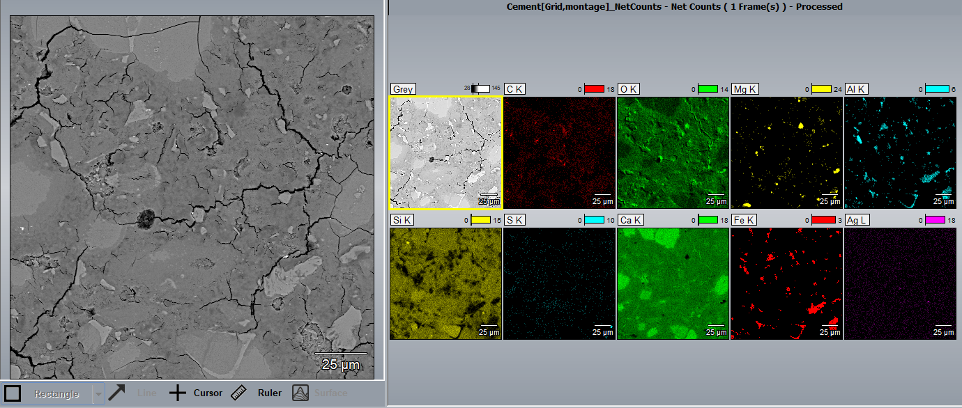

Slide 16
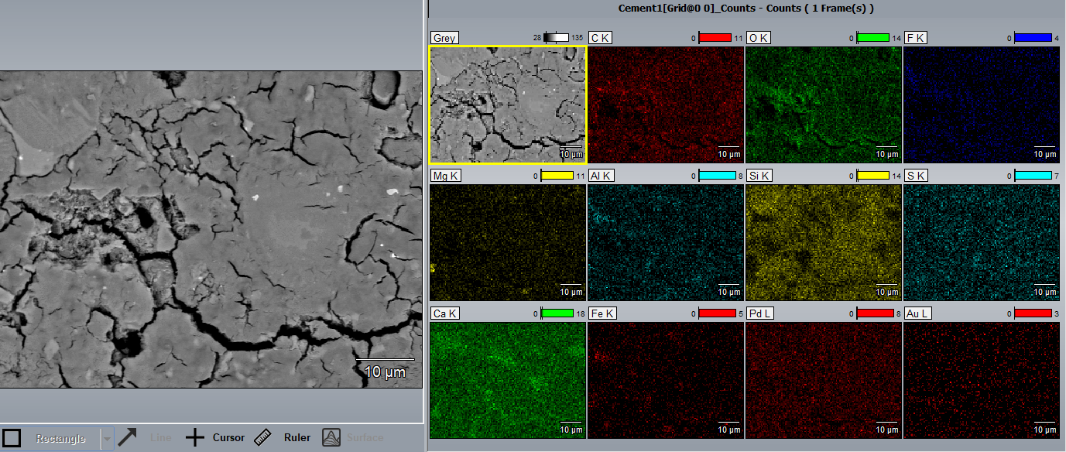

Slide 17
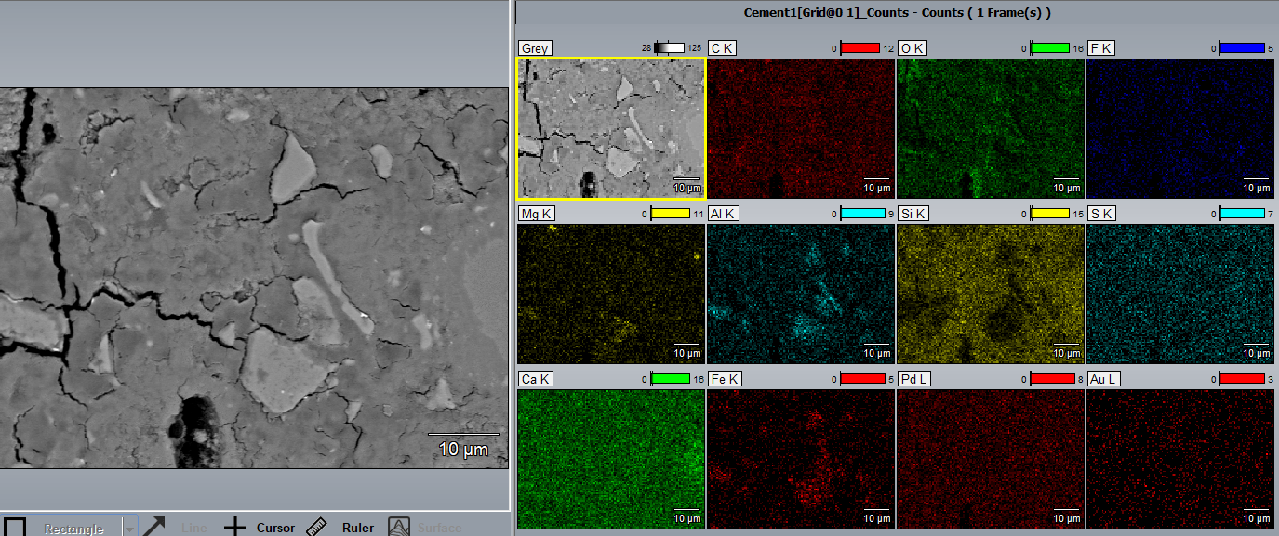

Slide 18
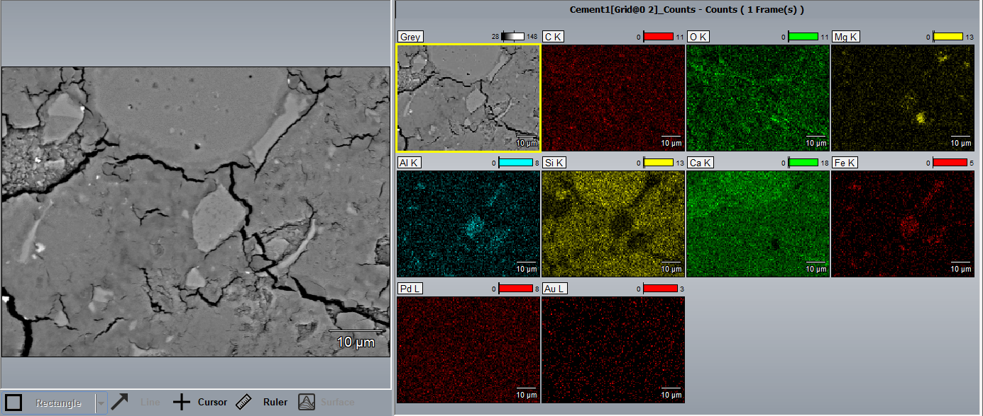

Slide 19
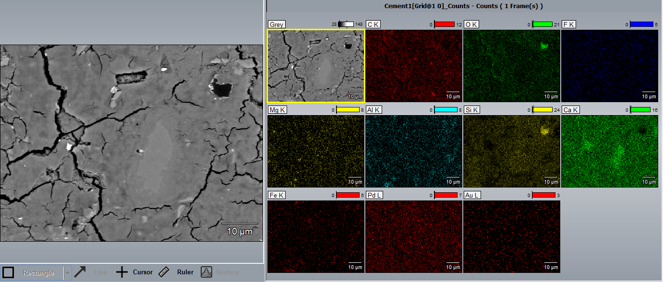

Slide 20
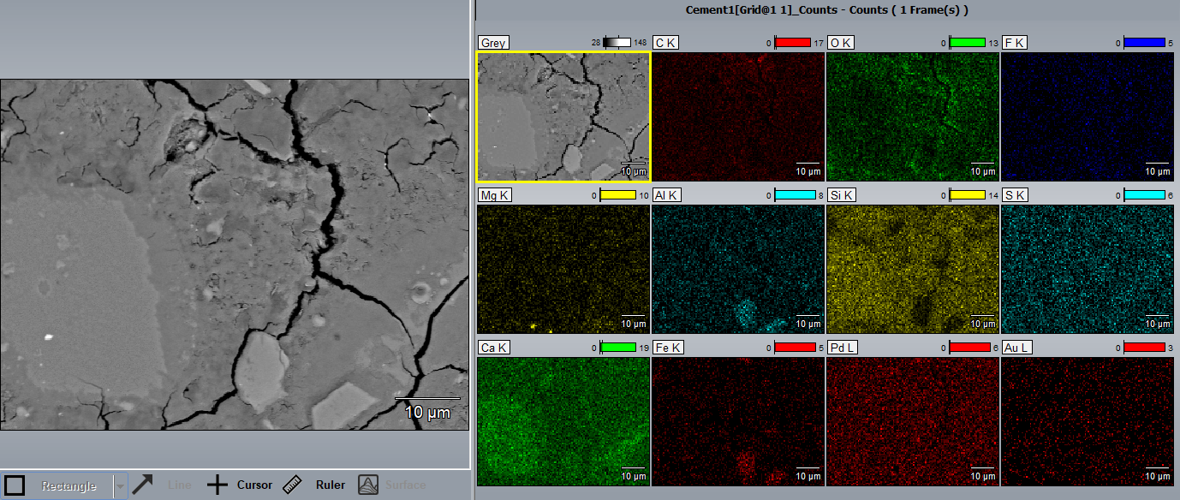

Slide 21
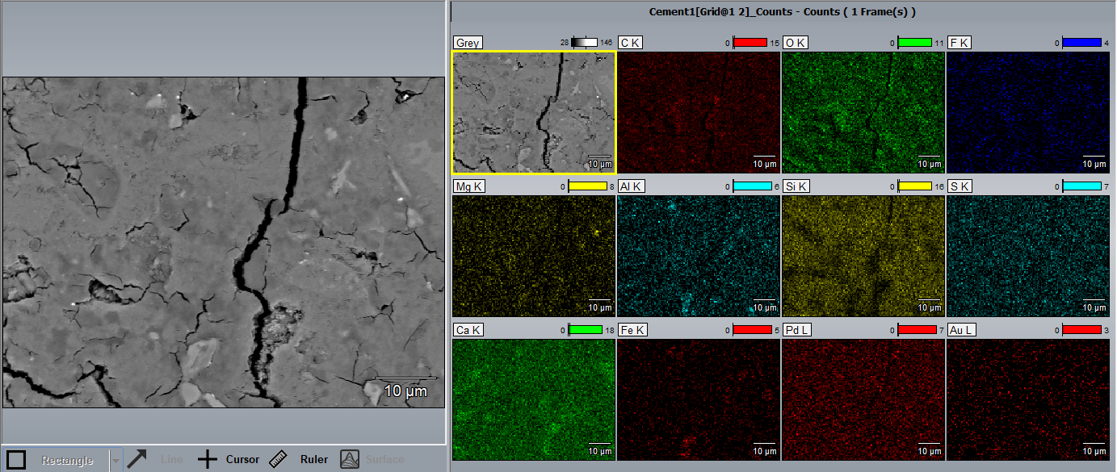

Slide 22
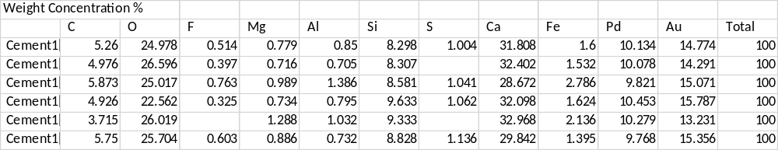

Slide 23
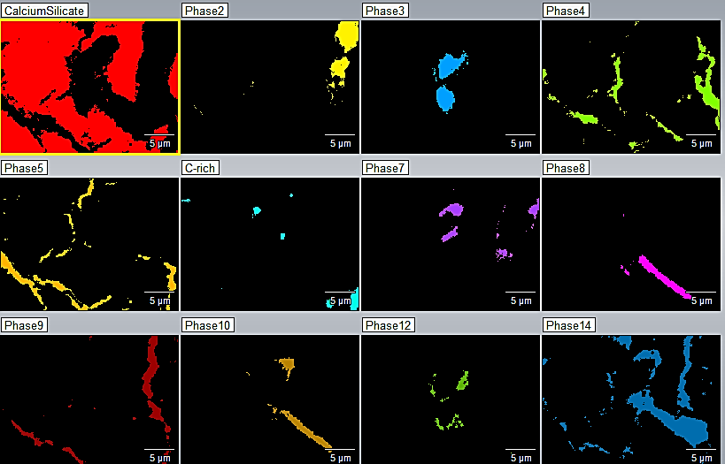

Slide 24
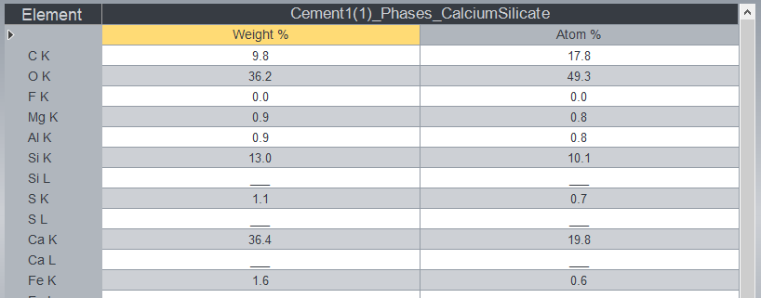
Phase 1 Ca-Si rich

Slide 25
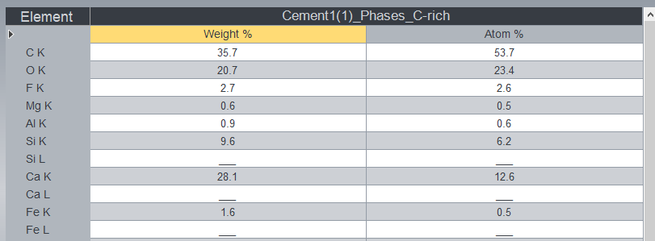
Phase 1 C rich

Slide 26
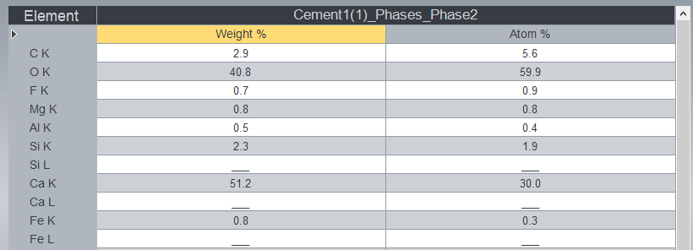
Phase2

Slide 27

Phase3

Slide 28
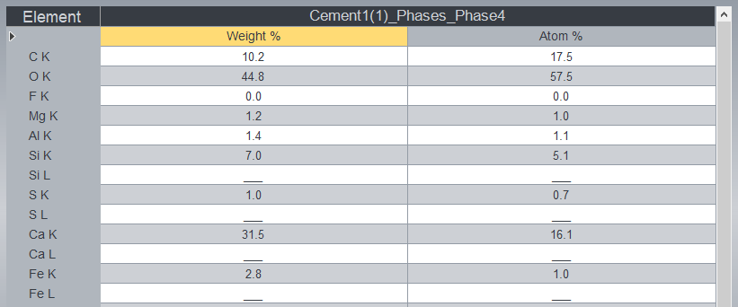
Phase4

Slide 29
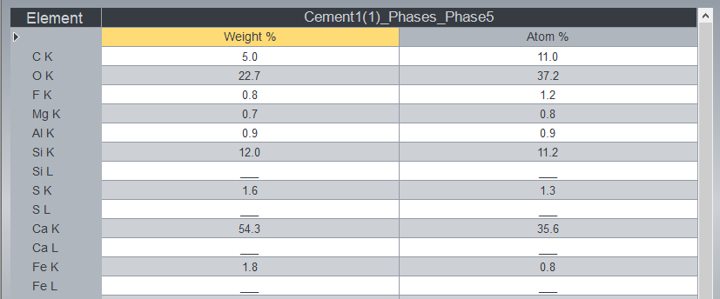
Phase5

Slide 30
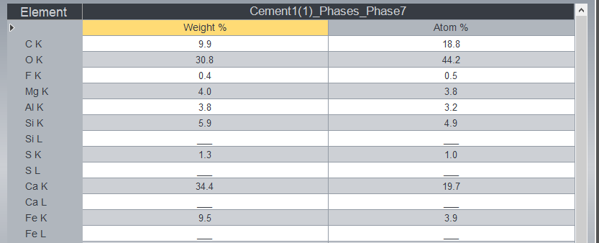
Phase7

Slide 31
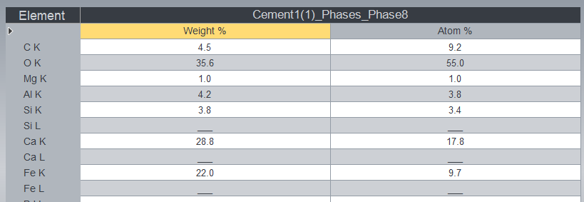
Phase8

Slide 32

Phase9

Slide 33
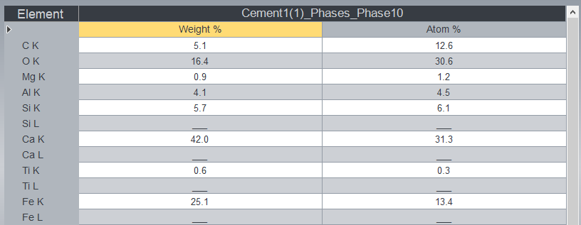
Phase10

Slide 34
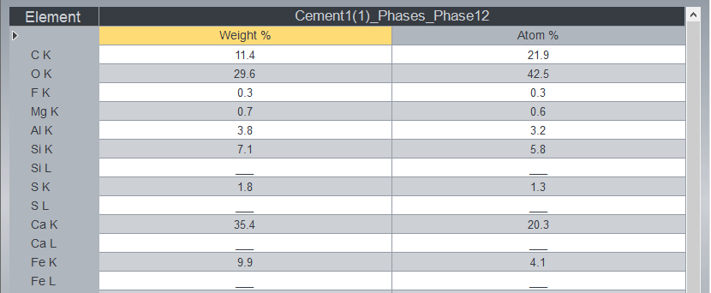
Phase12

Slide 35

Phase14

Slide 36
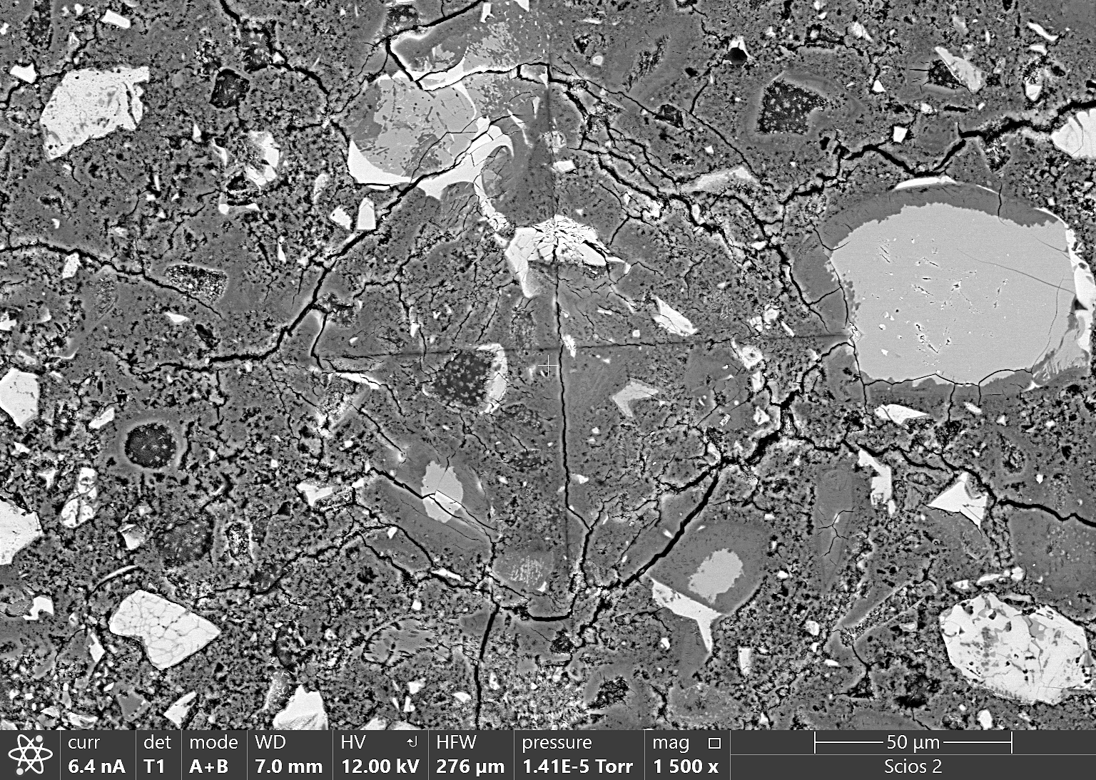
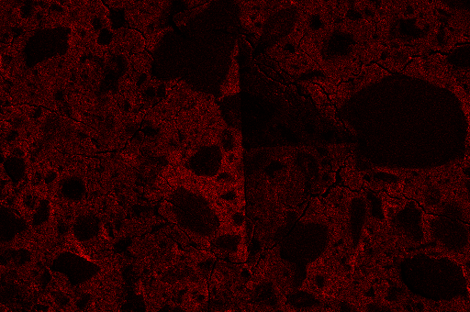
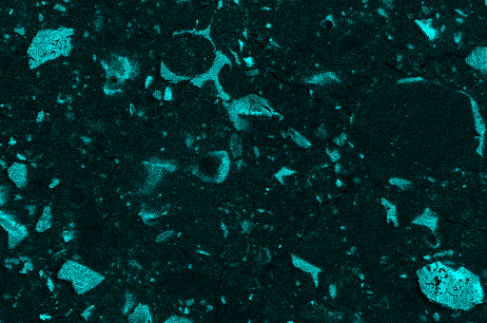
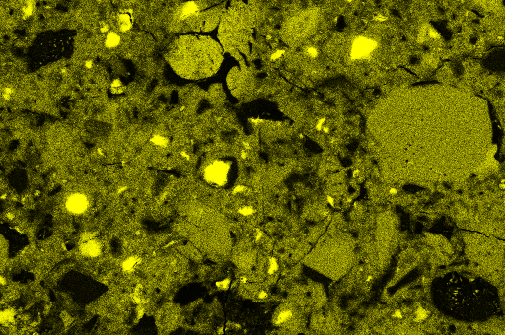
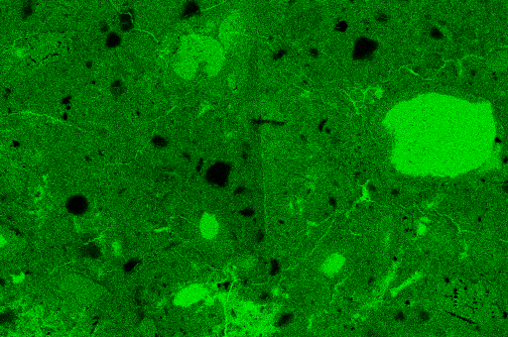
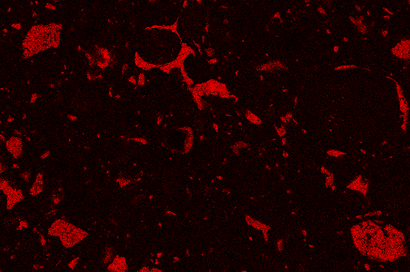
Neat
BSE
C
Al
Si
Ca
Fe

Slide 37
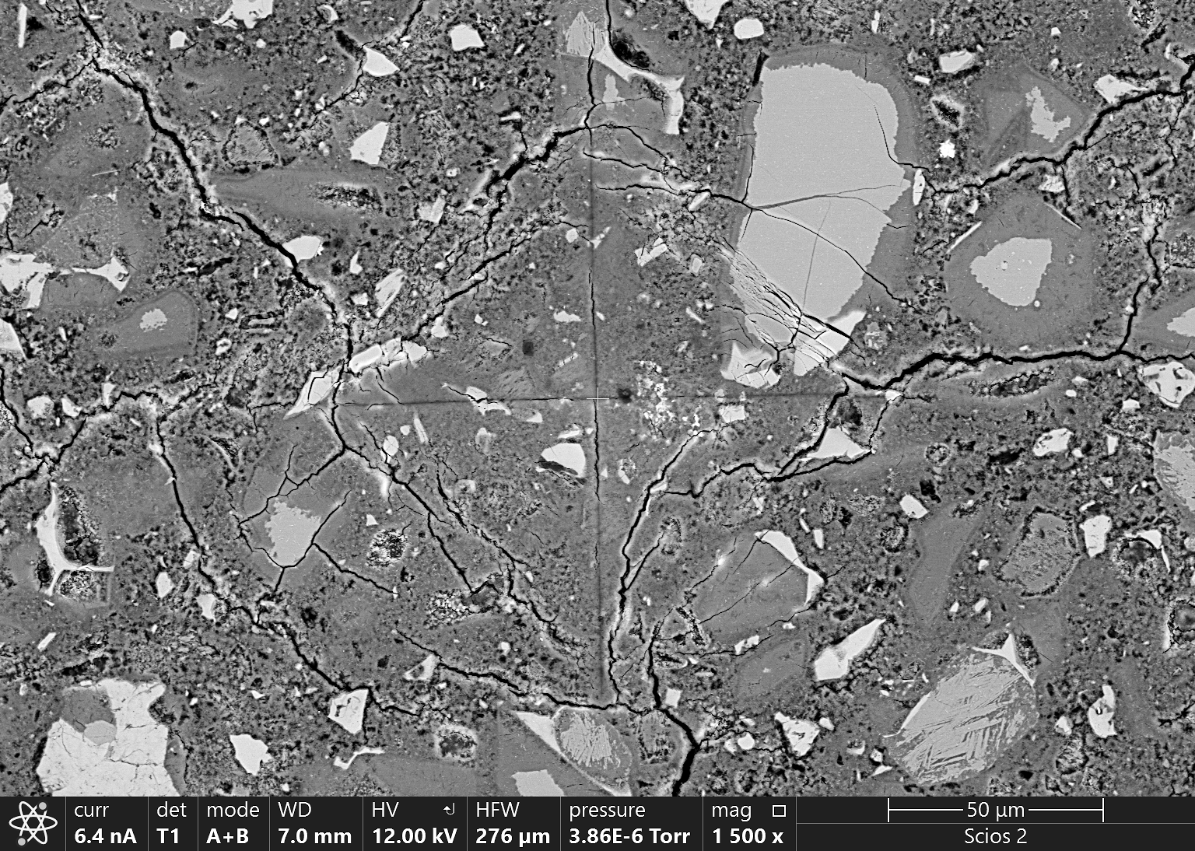
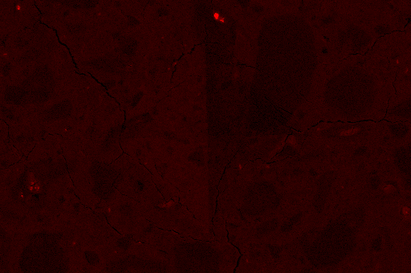
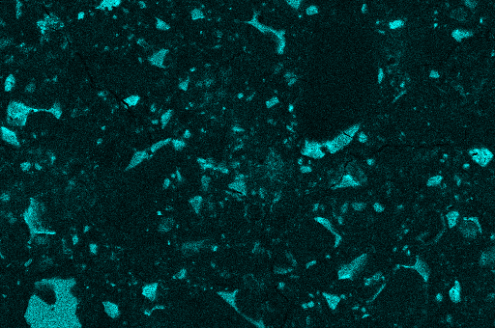
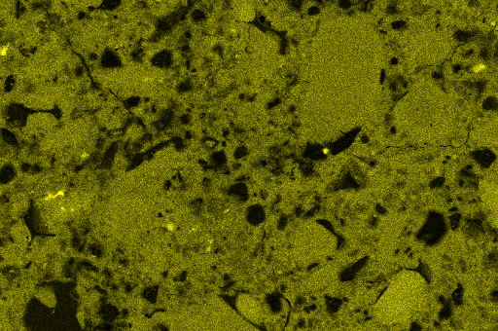
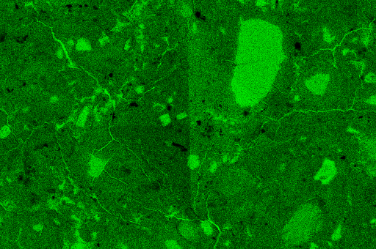
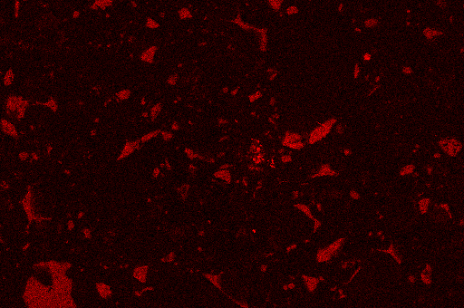
0.05%G
BSE
C
Al
Si
Ca
Fe

Slide 38
Neat
100 µm
100 µm
BSE
C
4
4
2
3
1
2
3
1
4
4
4
4
2
2
3
3
Si
Ca
4
4
2
3
1
2
3
1
4
4
4
4
4
2
2
3
3
Al
Fe
4
4
2
3
1
2
3
1
4
4
4
4
2
2
3
3

Slide 39
0.05%G
100 µm
BSE
5
C
5
2
2
1
1
3
3
5
4
5
4
2
2
3
1
3
1
Si
5
Ca
5
2
2
1
1
3
3
4
4
5
5
2
2
3
1
3
1
Al
5
Fe
5
2
2
1
1
3
3
5
4
5
4
2
2
3
1
3
1

Slide 40
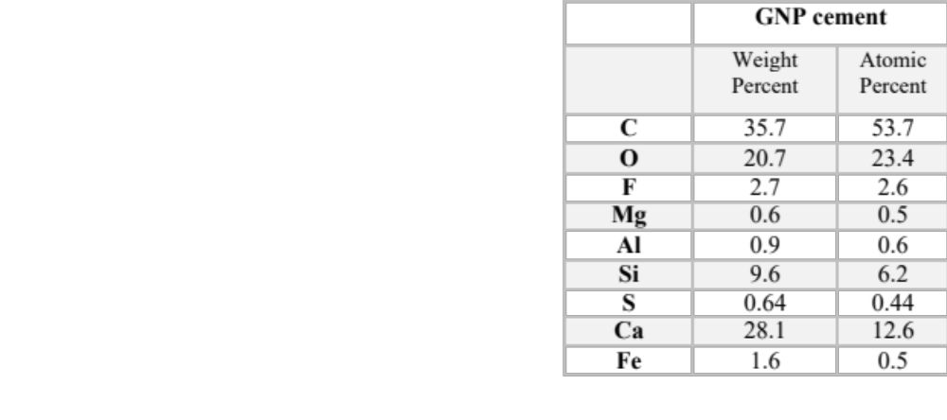

Slide 41
A
B
C
Pore Throat Size Histogram
Neat
0.05%GNP
Size Classification:
Size Classification:

Slide 42
Pore Throat Size Histogram
Neat
0.05%GNP

Slide 43
Pore Throat Size Histogram
Neat
Size Classification:
0.05%GNP
Size Classification:

Slide 44
Pore Throat Size Histogram
Neat
0.05%GNP
Size Classification:
Size Classification:

