Slide 1
Experimental Study of the Triaxial Test of Neat Cement and 0.1% Graphene Cement at Elevated Confining Pressure and Temperatures
Oklahoma State University & University of Pittsburgh
03.23.2020

Slide 2
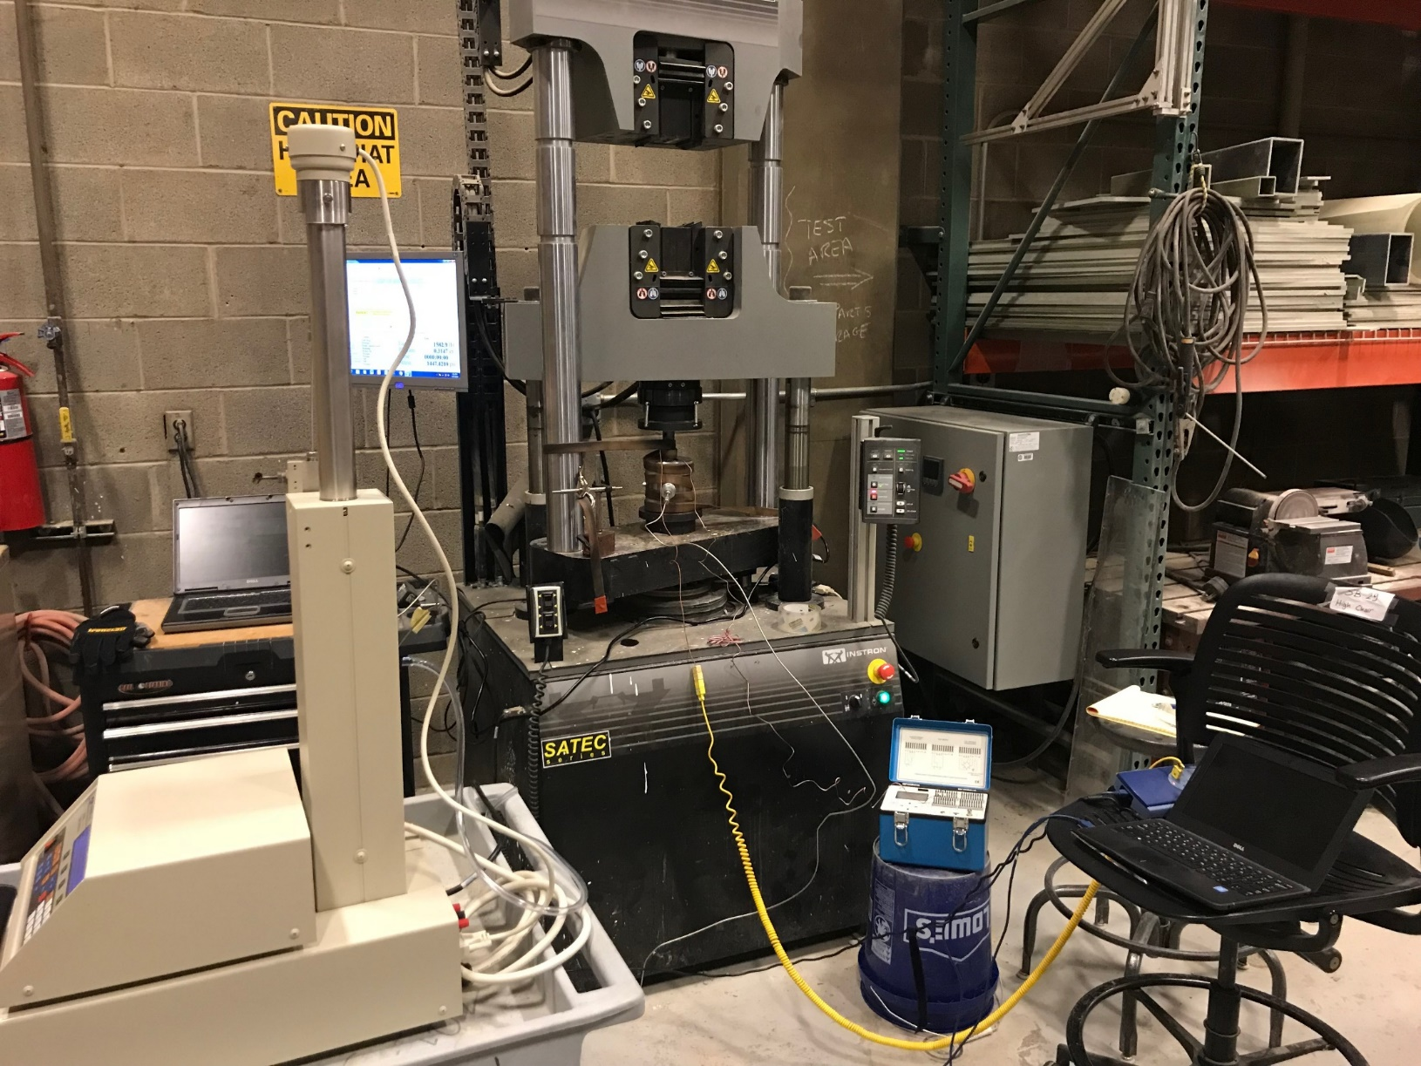
Test setup & procedures
Stress curve
Mohr-coulomb circle
Preliminary conclusions
Future Works
Experimental setup for the triaxial test at elevated temperatures
Instron for axial load
Hoek cell wrapped by heat tape
Syringe pumps for confining load
Temperature & strain change recording

Slide 3
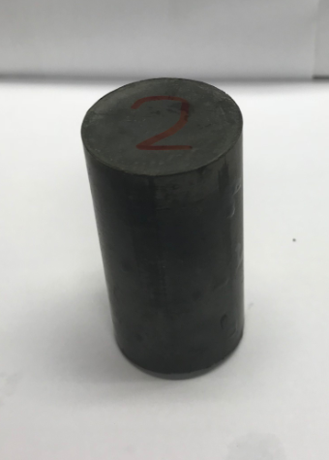
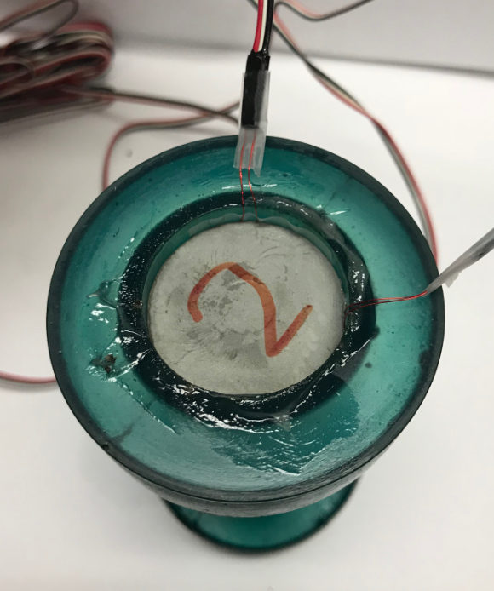
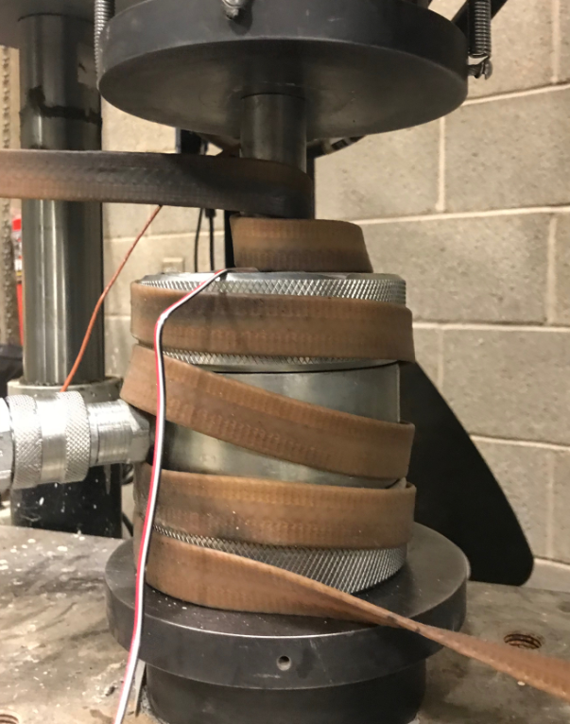
Test setup & procedures
Stress curve
Mohr-coulomb circle
Preliminary conclusions
Future Works
Experimental setup for the triaxial test at elevated temperatures
Strain gauge #1
Heat tape
Strain gauge #2
Thermocouple
Sample before loading into membrane (pre-test)
Sample in membrane with two strain gauges on side surface
Assembled Hoek cell wrapped by heat tape with temperature recording system (thermocouple)

Slide 4
Test setup & procedures
Stress curve
Mohr-coulomb circle
Preliminary conclusions
Future Works
Experimental procedures for the triaxial test at elevated temperatures (undrained test)
Glue strain gauges to side surface of sample and place the sample into Hoek cell with membrane. Then, assemble the Hoek cell to loading system.
By using heat tape, increase the system temperature to 90 degree Celsius at very low hydrostatic pressure (~100 psi). This step may take 2 to 2.5 hours.
Increase the isotropic stress of the system to the value of targeted confining pressure.
Follow the ASTM-D7012, start test at constant strain rate (0.2 mm/min) until the sample fails (usually the testing time will be around 10-12 mins).

Slide 5
Test setup & procedures
Stress curve
Mohr-coulomb circle
Preliminary conclusions
Future Works
Experimental procedures for the triaxial test at elevated temperatures (drained test)
Glue strain gauges to side surface of sample and place the sample into Hoek cell with membrane. Then, assemble the Hoek cell to loading system.
By using heat tape, increase the system temperature to 90 degree Celsius at very low hydrostatic pressure (~100 psi). This step may take 2 to 2.5 hours.
Increase the isotropic stress of the system to the value of targeted confining pressure and waiting the dissipation of the excess pore pressure (may take around 2 hours).
Follow the ASTM-D7012, start test at constant strain rate (0.2 mm/min) until the sample fails (usually the testing time will be around 10-12 mins).

Slide 6
Test setup & procedures
Stress curve
Mohr-coulomb circle
Preliminary conclusions
Future Works
Triaxial tests lists at elevated temperatures
(up to 3.23.2020):
Sample description | Testing temperature (℃) | Confining pressure (psi) | Drainage condition
Neat cement #1 | 90 | 2000 | undrained
Neat cement #2 | 90 | 6000 | undrained
Neat cement #3 | 90 | 6000 | drained
Neat cement #4 | 90 | 7500 | Failed (membrane damaged)
0.1% graphene #1 | 90 | 2000 | undrained
0.1% graphene #2 | 90 | 6000 | undrained
0.1% graphene #3 | 90 | 7500 | drained

Slide 7
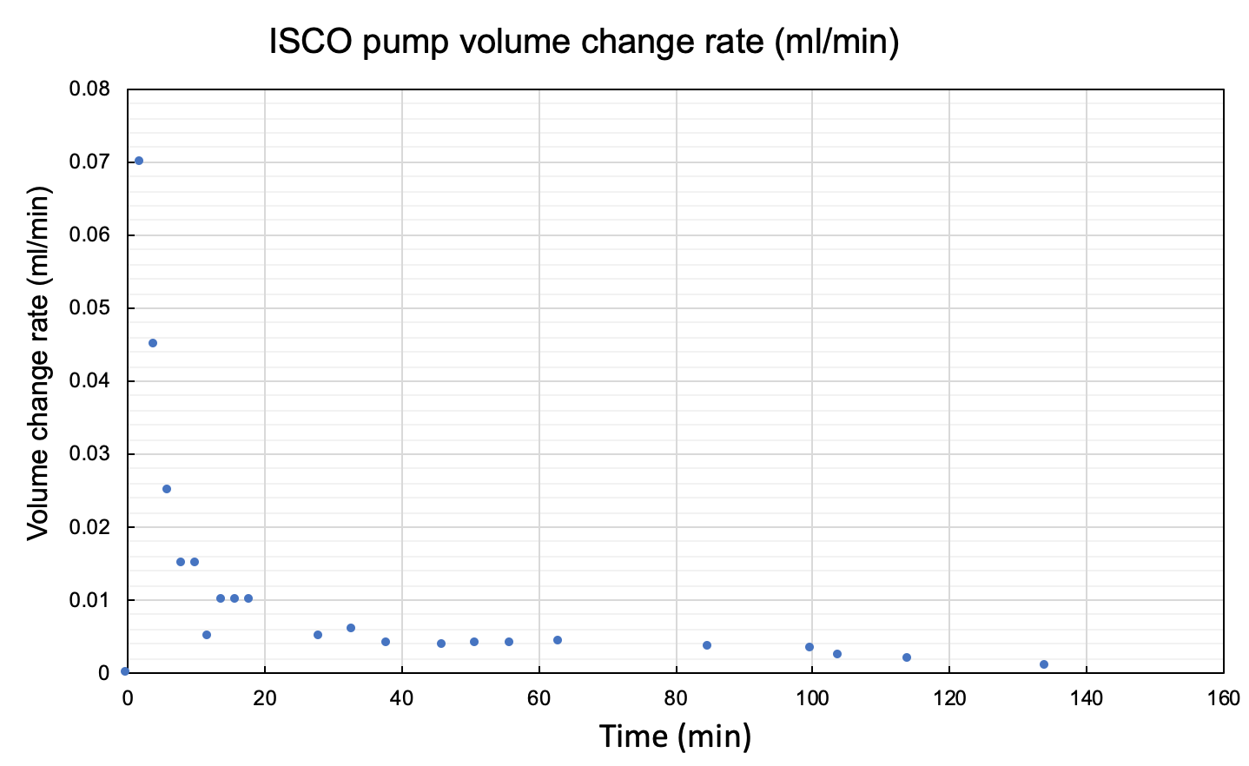
Consolidation period in drained test:
example from neat cement CP @ 6000 psi and 90 ℃ (drained test)
After increasing CP and before increasing DP

Slide 8
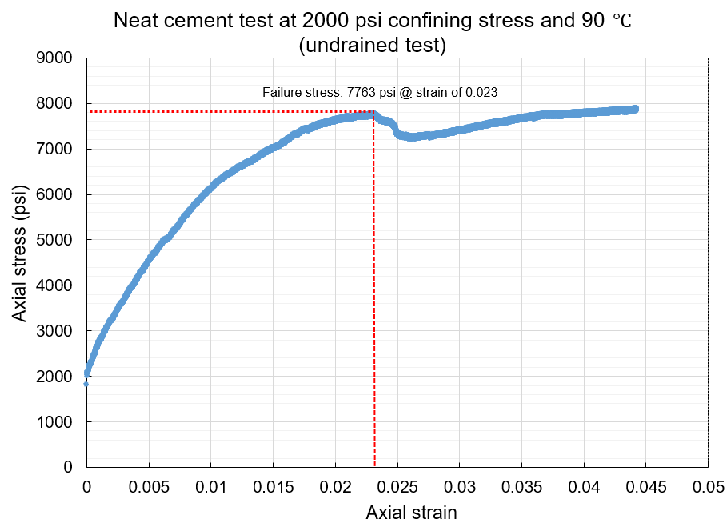
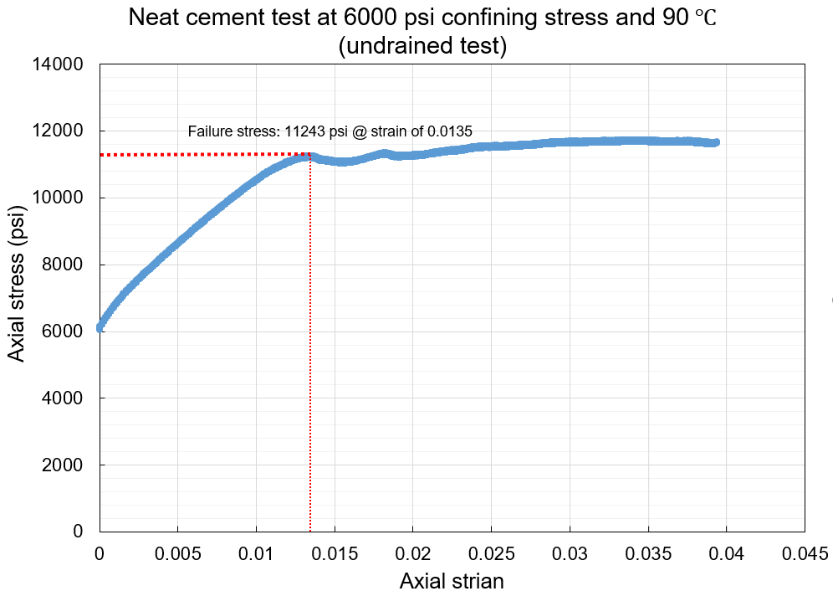
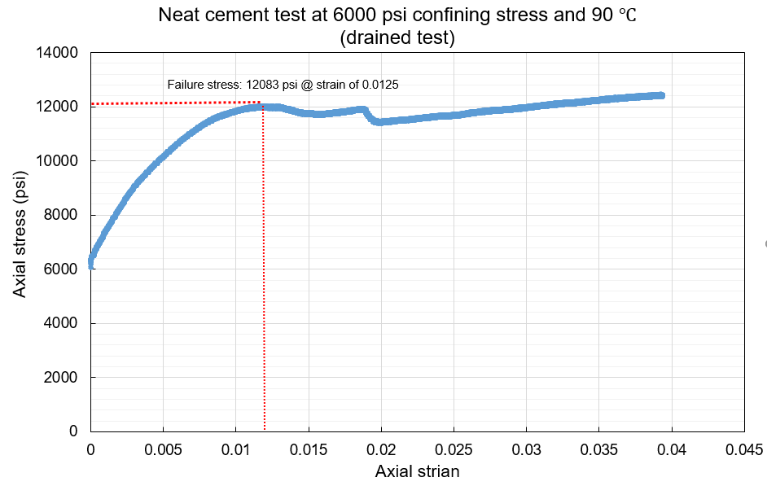
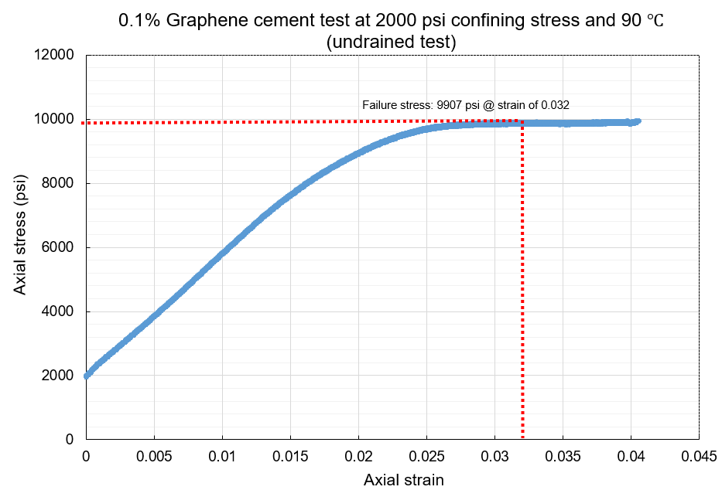
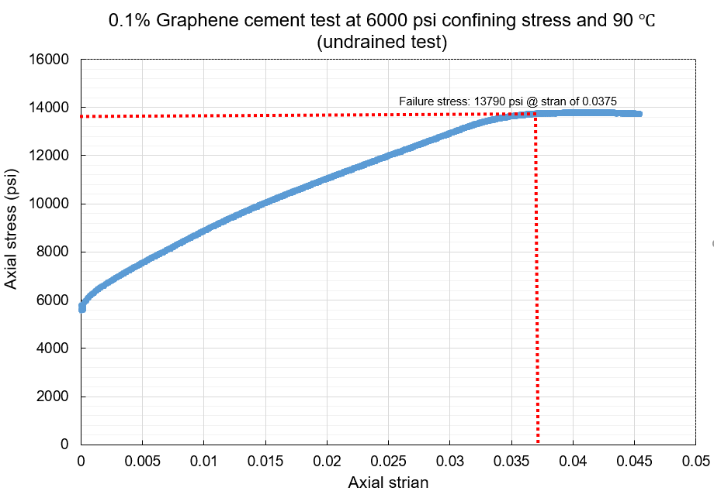
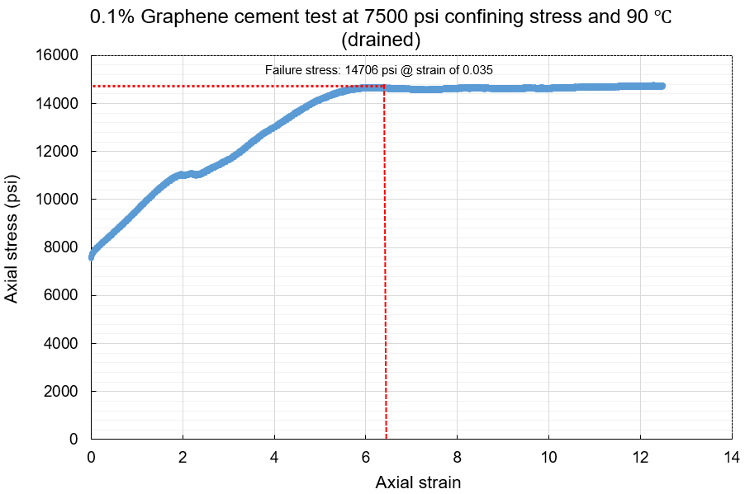
Test setup & procedures
Stress-strain curve
Mohr-coulomb circle
Preliminary conclusions
Future Works

Slide 9
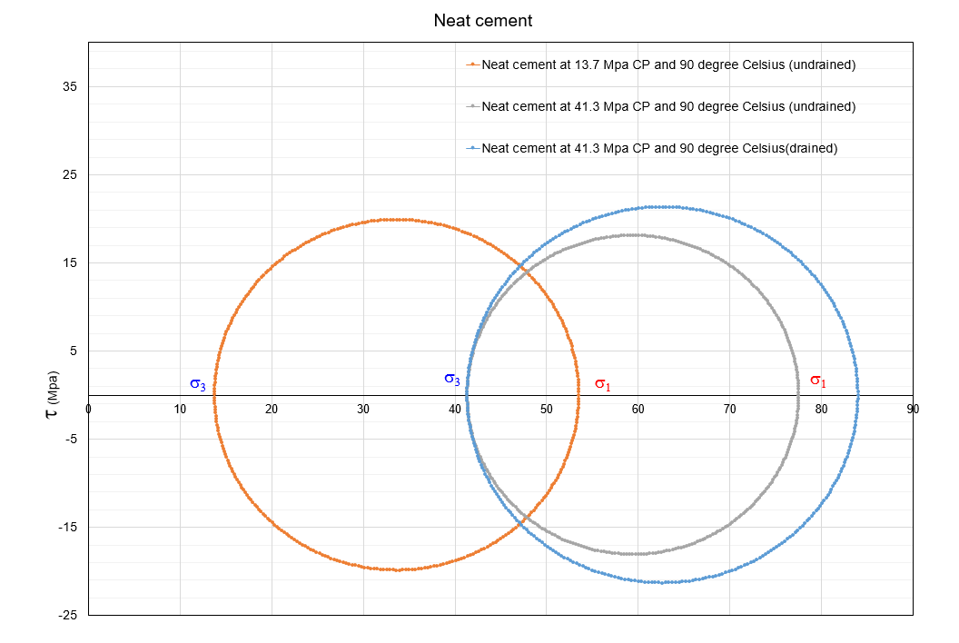
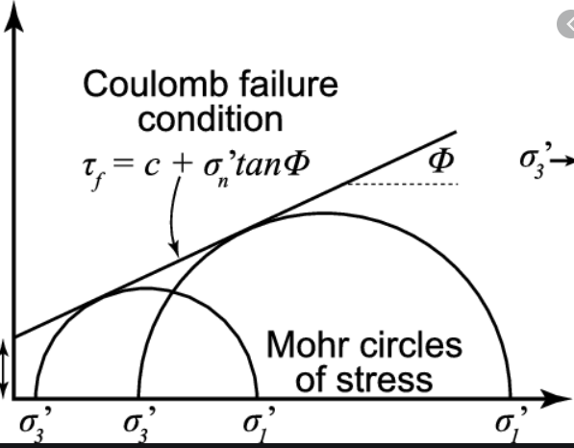
Test setup & procedures
Stress curve
Mohr-coulomb circle
Preliminary conclusions
Future Works
Φ = 5 degree, c = 19 Mpa

Slide 10
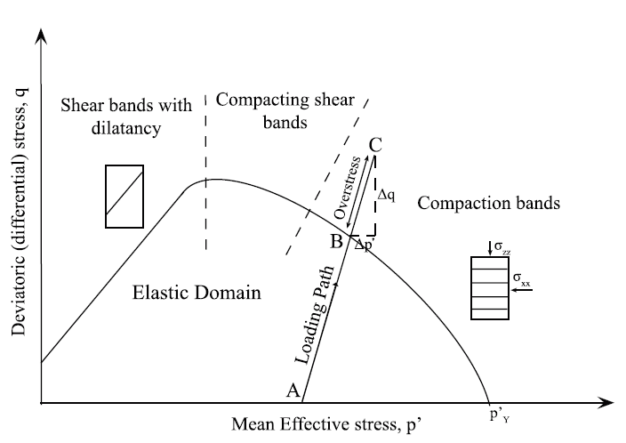
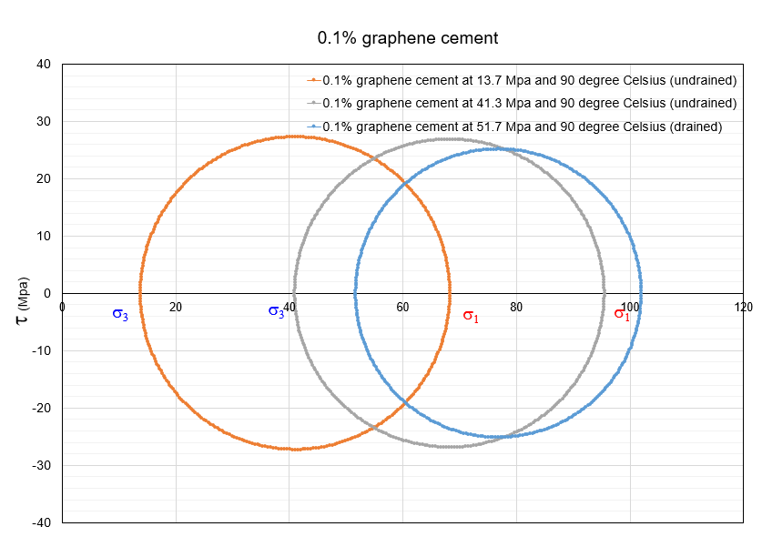
Test setup & procedures
Stress curve
Mohr-coulomb circle
Preliminary conclusions
Future Works

Slide 11
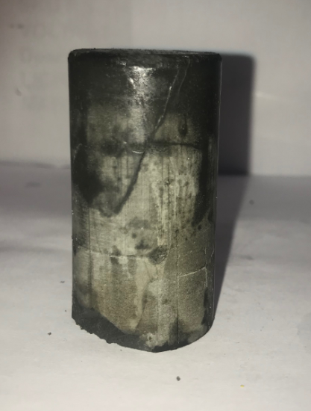
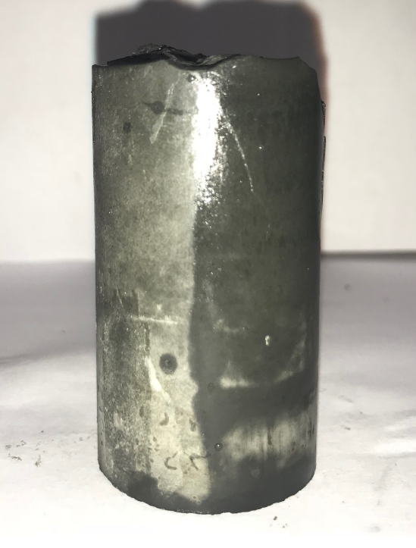
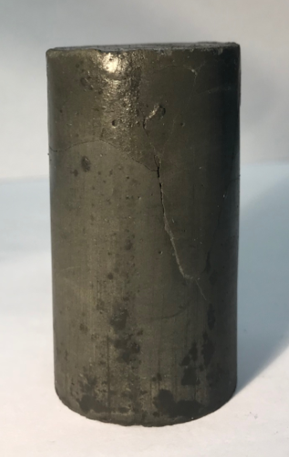
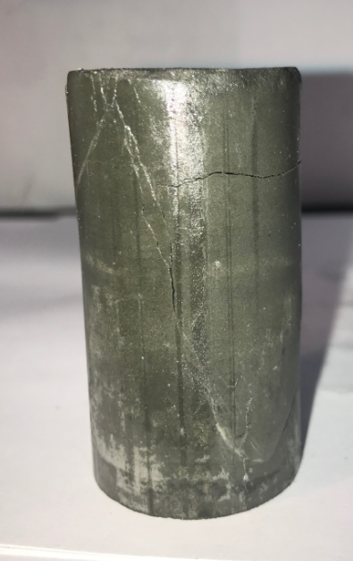
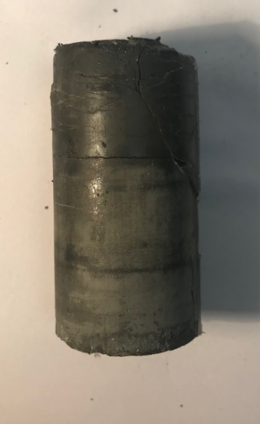
Test setup & procedures
Stress curve
Mohr-coulomb circle
Post-test failure patterns
Future Works
Preliminary conclusions
Post-test: sample failure patterns
Post-test (0.1% graphene @ 2000 psi CP & 90C)
Post-test (0.1% graphene @ 6000 psi CP & 90C)
Post-test (0.1% graphene @ 7500 psi CP & 90C)
Post-test (neat @ 2000 psi CP & 90C)
Post-test (neat @ 6000 psi CP & 90C)

Slide 12
Test setup & procedures
Stress curve
Mohr-coulomb circle
Preliminary conclusions
Future Works
Triaxial tests lists at elevated temperatures
(up to 3.23.2020):
Sample description | Testing temperature (℃) | Confining pressure (psi) | Drainage condition | Shear stress at failure (psi)
Neat cement #1 | 90 | 2000 | undrained | 7763
Neat cement #2 | 90 | 6000 | undrained | 11243
Neat cement #3 | 90 | 6000 | drained | 12083
Neat cement #4 | 90 | 7500 | Failed (membrane damaged) | N/A
0.1% graphene #1 | 90 | 2000 | undrained | 9907
0.1% graphene #2 | 90 | 6000 | undrained | 13790
0.1% graphene #3 | 90 | 7500 | drained | 14706

Slide 13
Test setup & procedures
Stress curve
Mohr-coulomb circle
Preliminary conclusions
Preliminary conclusions:
Under undrained conditions, cement with 0.1% graphene has higher shear strength than neat cement. At the same testing conditions, the shear strength of 0.1% graphene cement is around 15%-25% larger than neat cement.
But this conclusion is currently only limited to the conditions that the confining stress is not higher than 6000 psi and test is under undrained conditions.
Under drained conditions, due to the damaged membrane and limited samples, the data size from both cases are too small to compare. More samples are needed.
Factors may influence the results:
Uneven/rough end surface of sample (main factor)
Long heat and consolidation periods cause the creep of sample

Slide 14
Test setup & procedures
Stress curve
Mohr-coulomb circle
Preliminary conclusions
Future works:
0.05% graphene cement will be tested at the current conditions to investigate the relationship between increment of concentration of graphene and the change of shear strength.
FLEX cement will also be tested at the current conditions to obtain the shear stress at failure and Mohr-coulomb circle
Discussion points:
Micro-structure analysis and/or chemical reactions between graphene and cement may need to be done for explaining the shear strength increment and more ductile strain-stress trend of graphene mixed cement.

