Slide 1
Raman microscope: Graphene and graphene cement
Cody Massion

Slide 2
Literature
Literature suggested Raman peaks for cement phases:
Hydrated Portland cement generally consists of:
  calcium silicate hydrate or C-S-H((CaO)_{1.65}(SiO₂)(H₂0)_{1.75}) – 1081, 707, 278cm⁻¹
  portlandite or calcium hydroxide (Ca(OH)₂) - 350cm⁻¹
  gypsum (CaSO₄ · 2H₂O) – 172, 1156cm⁻¹
  ettringite or calcium sulfoaluminate (Ca₆Al₂(SO₄)₃(OH)₁₂·26H₂O) - 991cm⁻¹
And some unhydrated products like:
  tricalcium silicate (3Ca · SiO₂) – 809-936cm⁻¹
  dicalcium silicate (2Ca.SiO₂)
  tricalcium aluminate (3Ca · Al₂O₃) – 504, 757cm⁻¹
  tetracalcium alumino ferrite (4CaO · Al₂O₃ · Fe₂O₃).

Slide 3
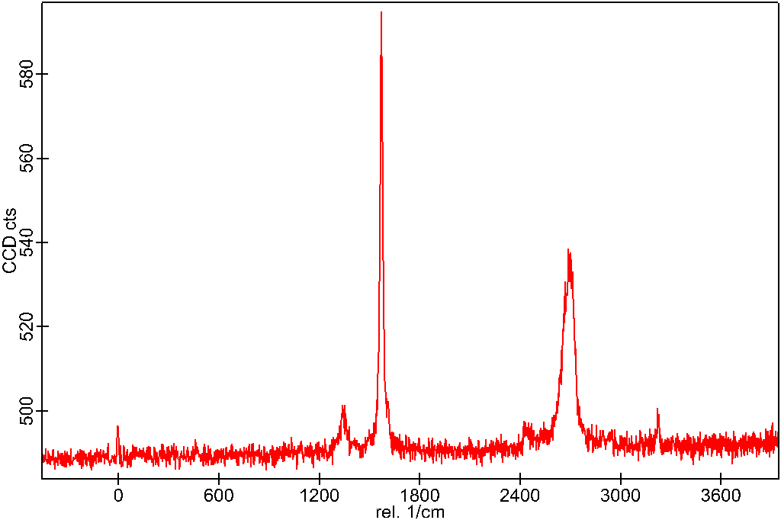
Results: Graphene
Graphene consists of 3 main peaks:
D – ranges from 1300-1400cm⁻¹
G – ranges from 1500-1600cm⁻¹
2D - ranges from 2650-2700cm⁻¹
Ratio of D to G peaks can indicate the amount of impurities found within the graphene, while G to 2D ratio is affected by the number of layers of graphene.
G
2D
D
Figure 1 – Raman spot spectrum conducted on as received Platinum graphene nanoplatelets.

Slide 4
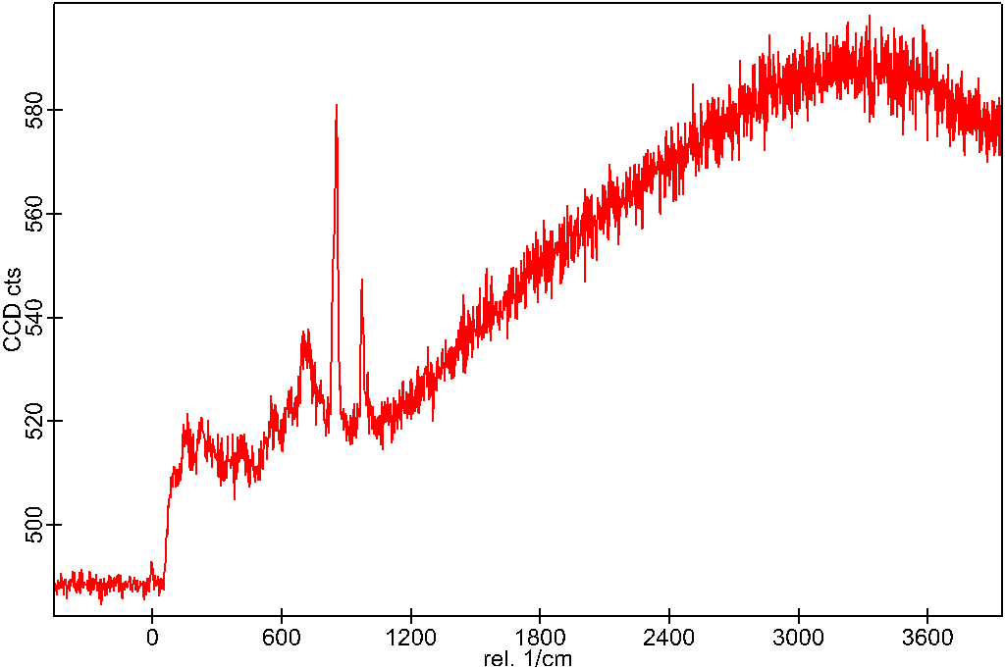
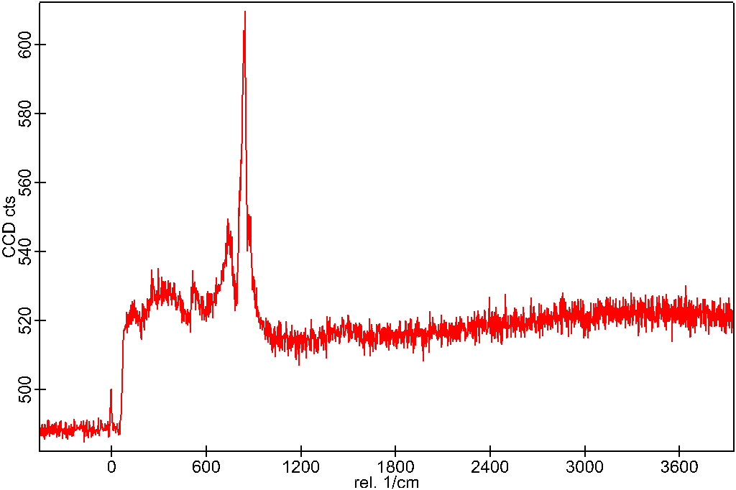
Results: Neat vs 0.1%woc Graphene
Neat Class-H
0.1%woc Graphene
A
B
C₃S
C₃S
CSH
CSH
C₃A
CSH
C₃A
CSH
CH
C₃A
CH
Figure 2 – Raman spot spectrum of hydrated and polished A) Neat Class-H cement B) 0.1%woc graphene added.

Slide 5
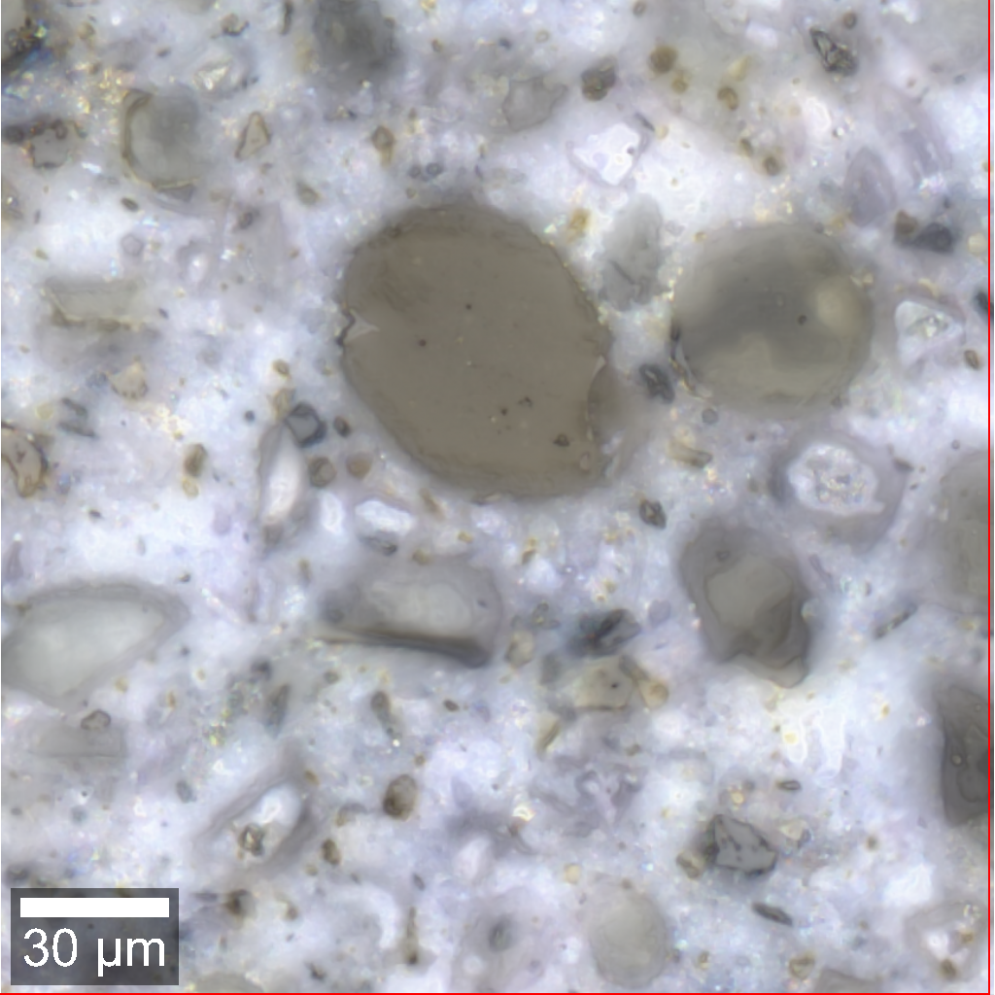
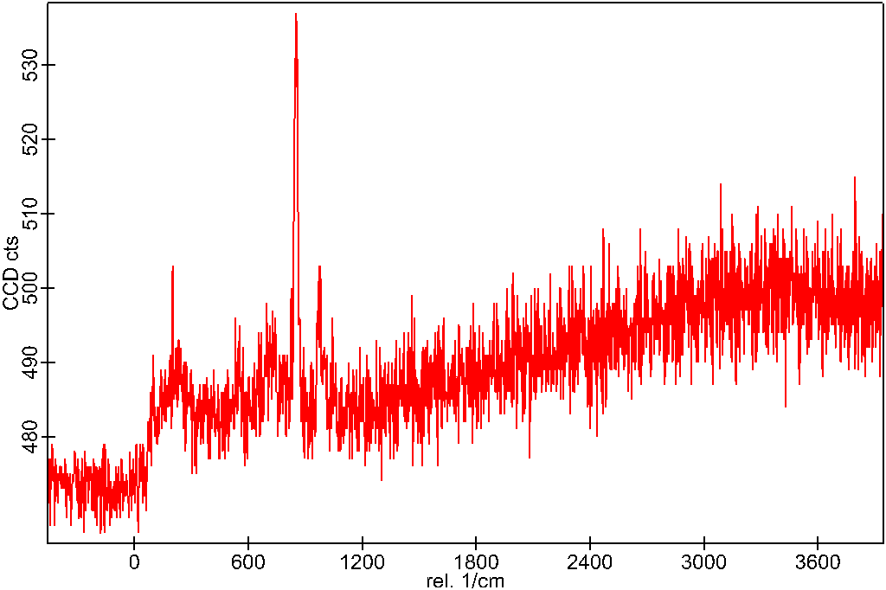
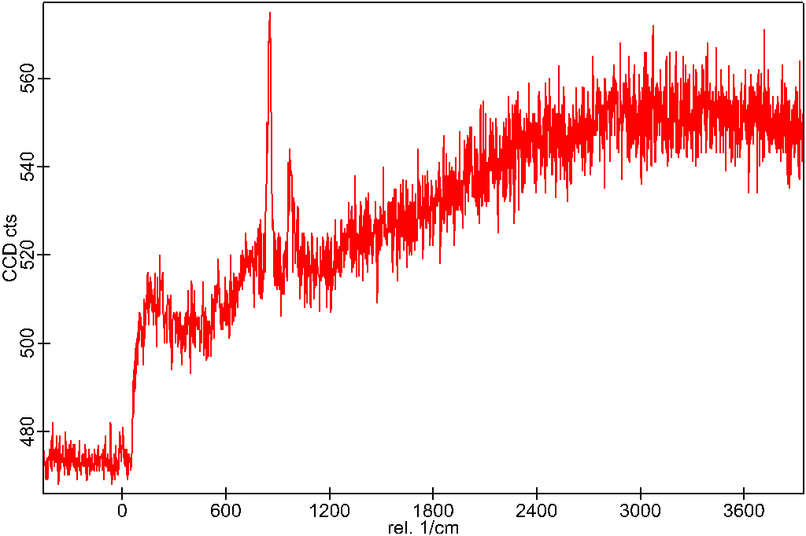
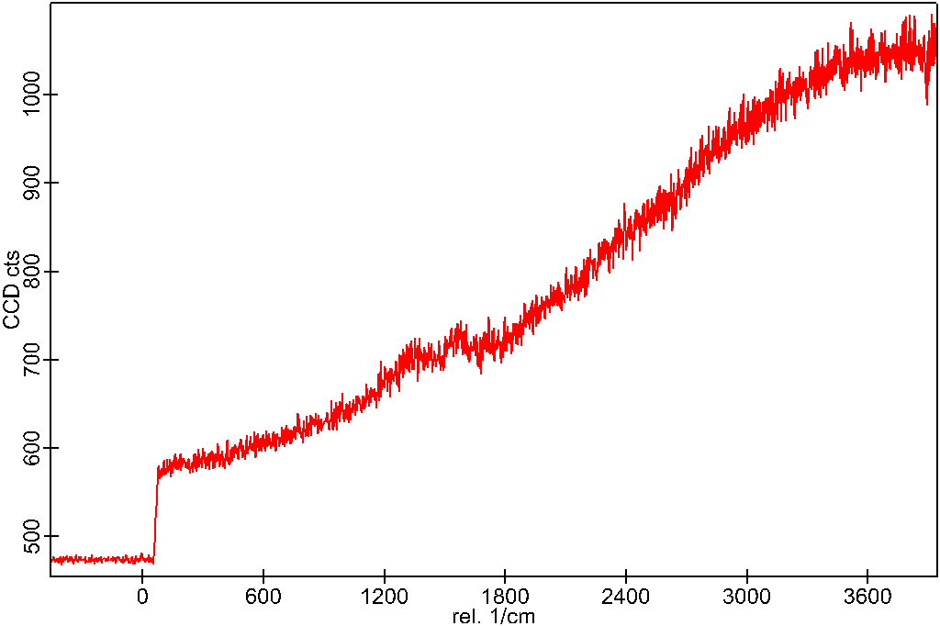
A
B
A
B
C
C
Figure 3 – Raman area spectrum of 0.1%woc graphene added with 3 different areas selected to compare spectrums.

Slide 6

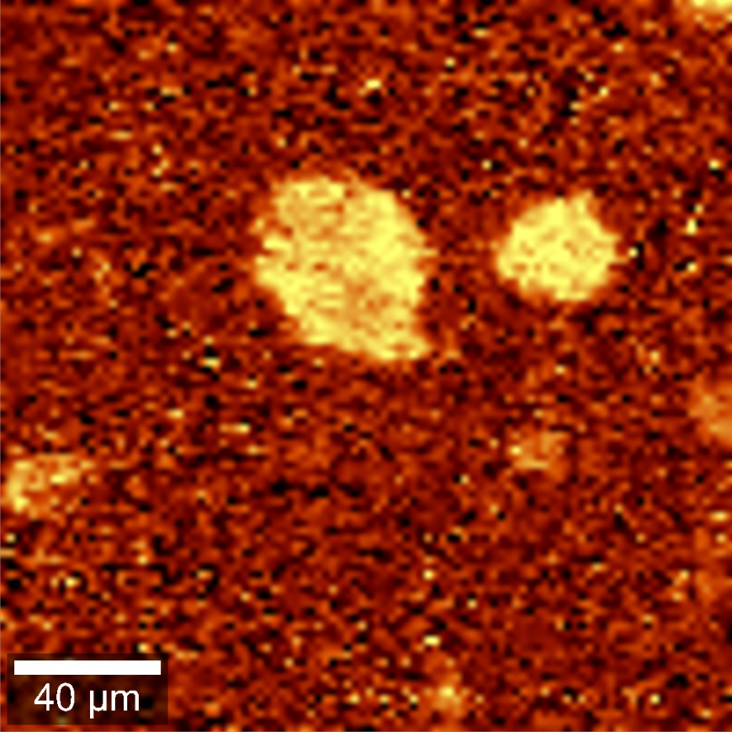
Results: 0.1%woc Graphene
Large grains appear bright in the range of 810-900cm⁻¹ indicating high intensity of materials in that range. Possible unhydrated cement phases such as C₃S, having a spectrum of 809-936cm⁻¹.
Figure 4 – Raman spectrum range of approximately 810-900cm⁻¹ of hydrated and polished 0.1%woc graphene in cement to view and identify large grains.

Slide 7

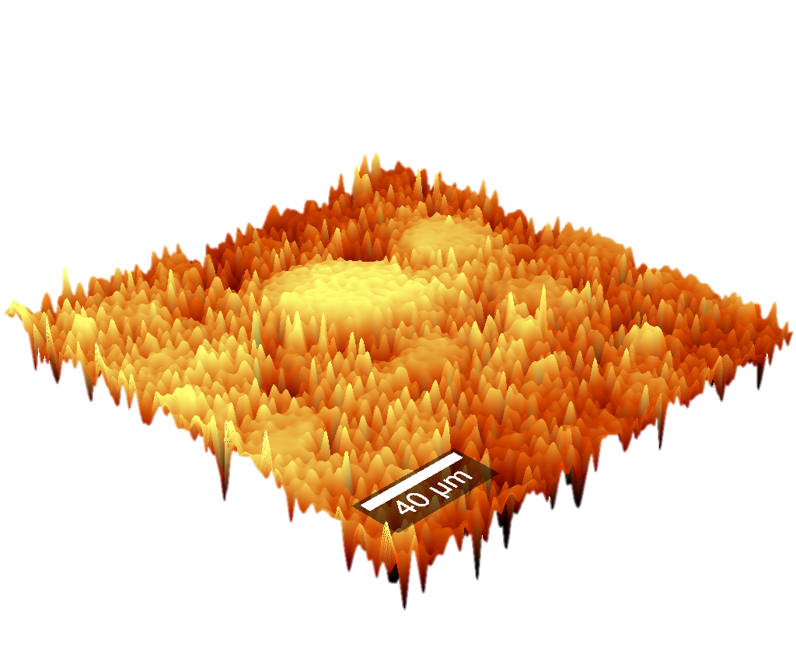
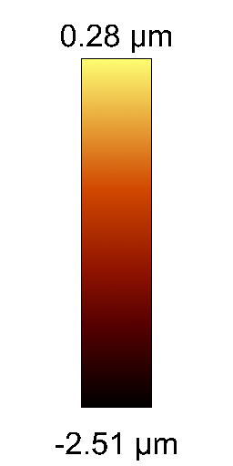
Raman scan of a 200µm by 200µm area of polished 0.1%woc graphene with a depth profile. Dark and nearly black areas indicates pore space within the cement sample. Polished surface roughness is show to be approximately 0.25 to 0.28µm within this area.
Figure 5 – Raman profilometer 3-dimensional rendering of polished cement surface.

