Slide 1
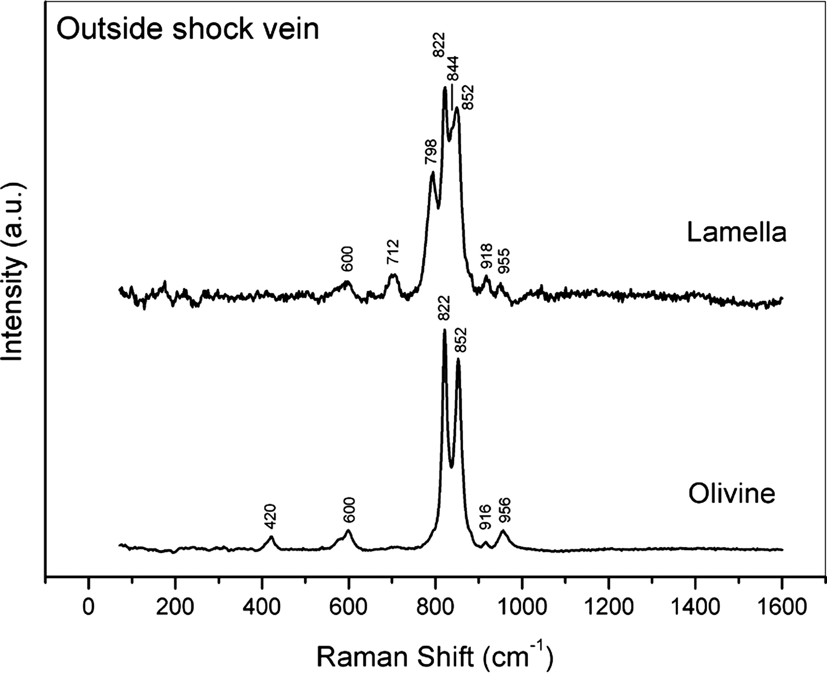
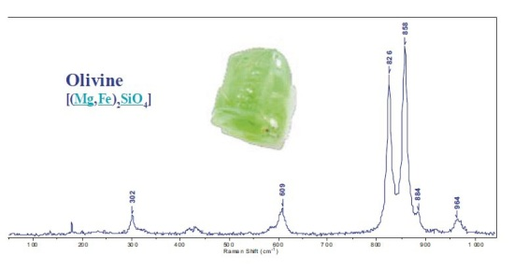
Raman Spectrum and peaks
Olivine
Olivine
The Raman spectrum of this mineral reveals high bending modes from 300 to 650cm⁻¹ and stretching modes between 800 and 1000cm⁻¹.

Slide 2
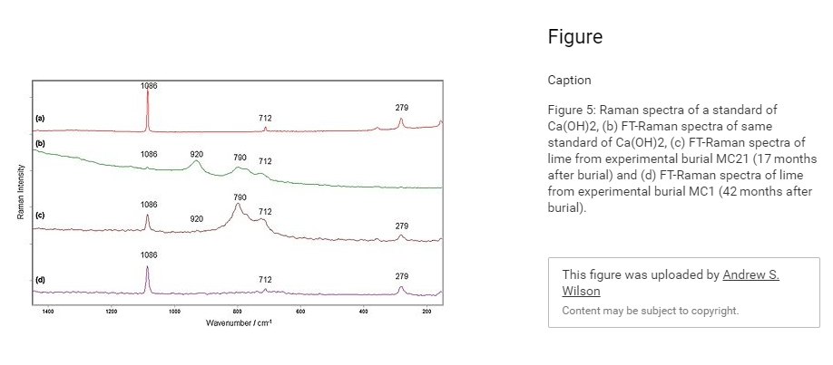

Slide 3
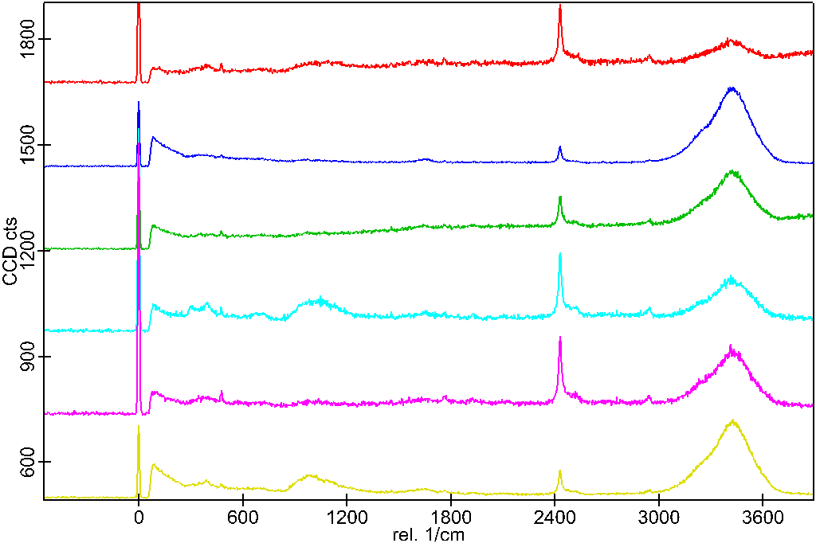
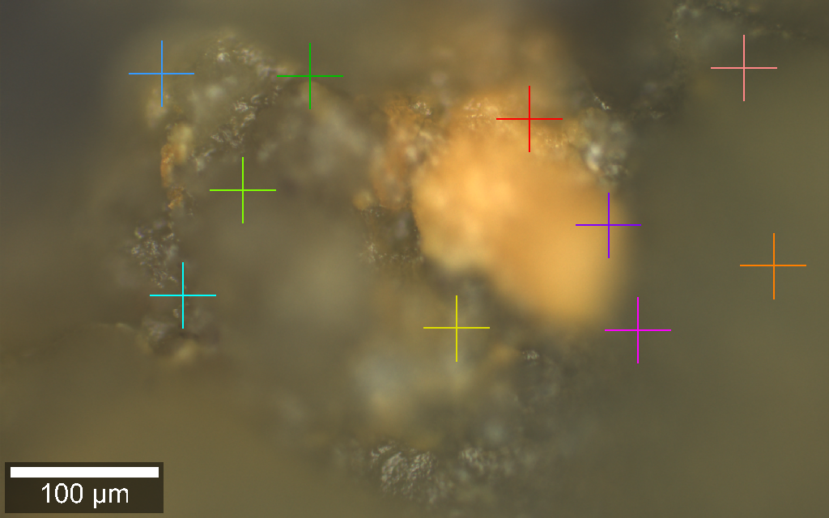
Olivine in HCl
2434
3427
6
111
6
8
5
5
7
4
4
2434
3427
3
2
3
111
964
9
1
10
2
1
111
Figure ***: Raman spectrum and optical image of olivine in HCl. From 10 points scans, seen on (b), there is spectrum(a) appear to have the same composition and no olivine peaks are present. The peaks from 3000-365, depict stretching vibrations of free OH group. Oxygen-Oxygen stretching group is at about 111-175 and peak 2444 is carbon materials.
3625 – Stretching vibration of the free OH groups - BY I. PERNOLL AND U. MAIER 1974
175- O…O stretching vibration
No trace of Olivine+
964 not sure what it is?

Slide 4
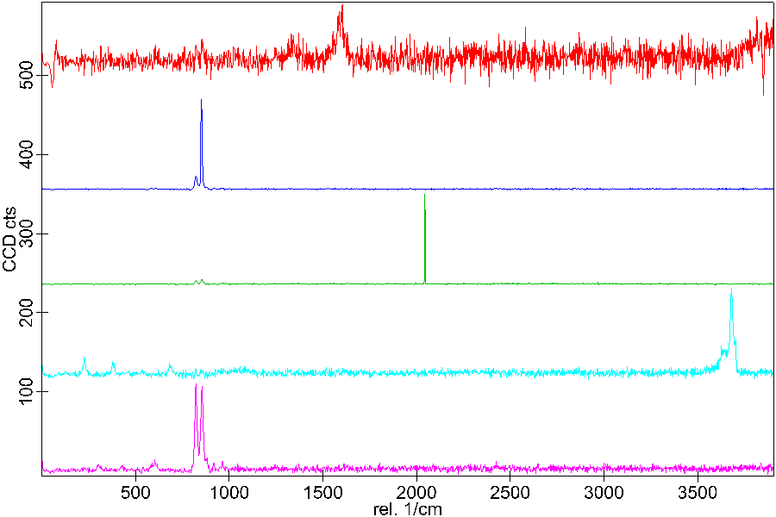
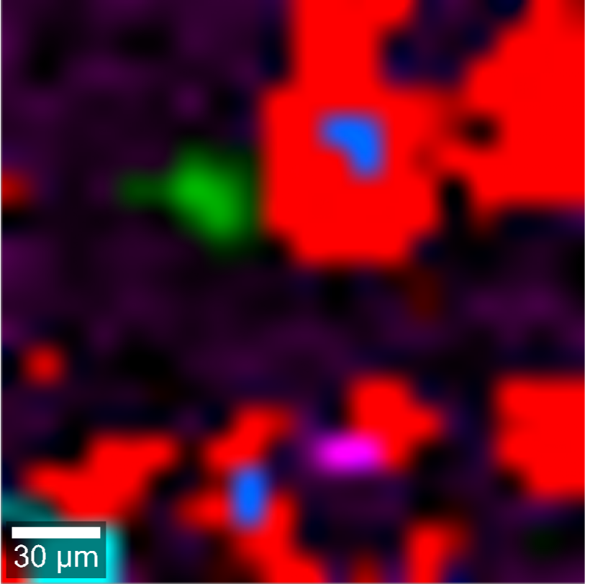
Olivine in NaCl
(a)
1597
(b)
Combine image
862
2043
3688
828
862
609
Figure ***: (a) Raman spectrum, (b) mineral map of olivine in DI-water. The spectrum peaks that need to be identified and The background is black, Red is Olivine and blue is made of 1597 is carbon material
3688 – Spectrum of NaCl
Background is red

Slide 5
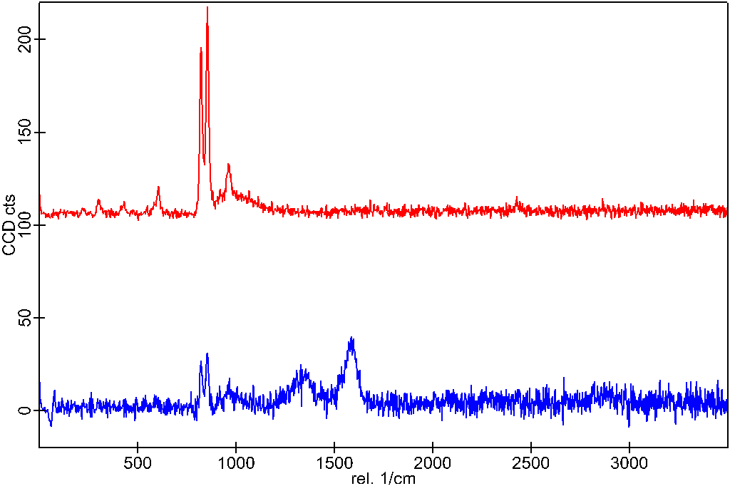
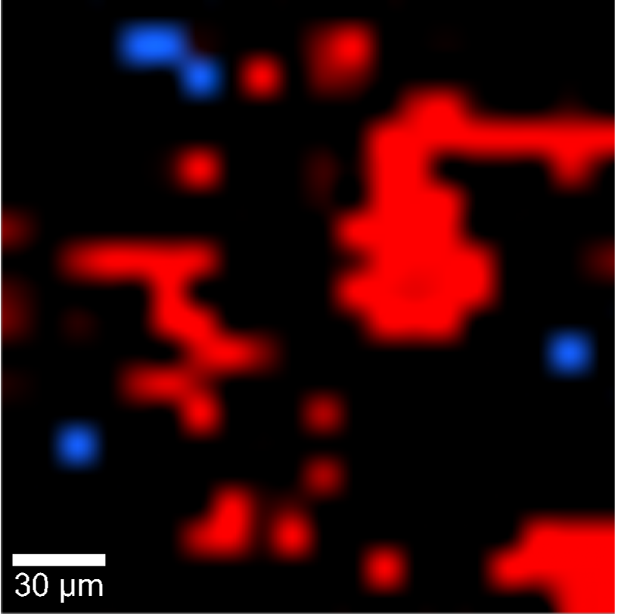
Olivine in DI-water
(a)
863
(b)
Combine image
820
609
1587
297
427
863
1589
820
1347
Figure ***: (a) Raman spectrum, (b) mineral map of olivine in DI-water. The spectrum peaks that need to be identified and The background is black, Red is Olivine and blue is made of

Slide 6
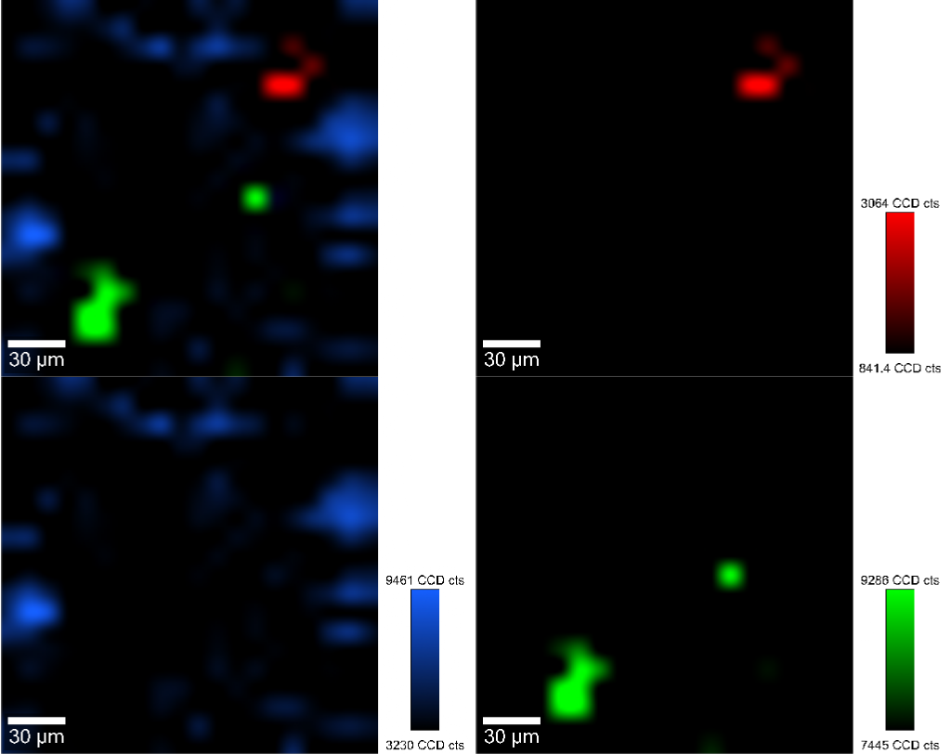
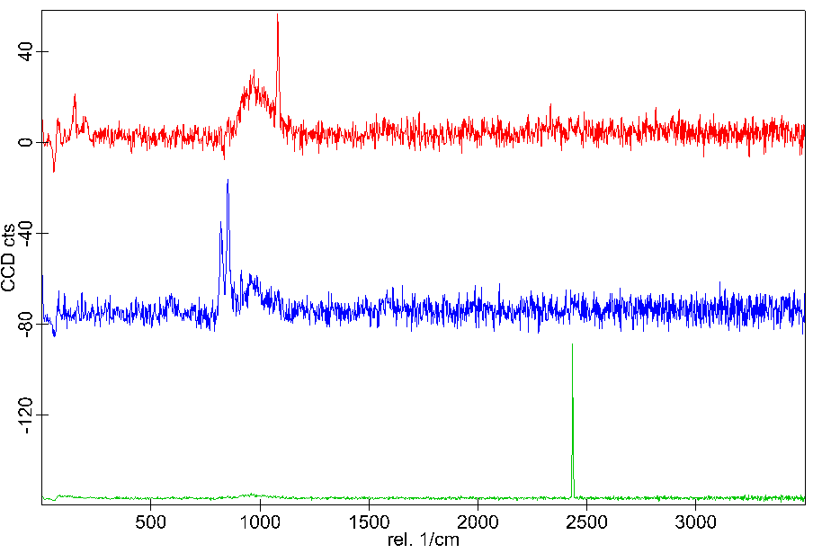
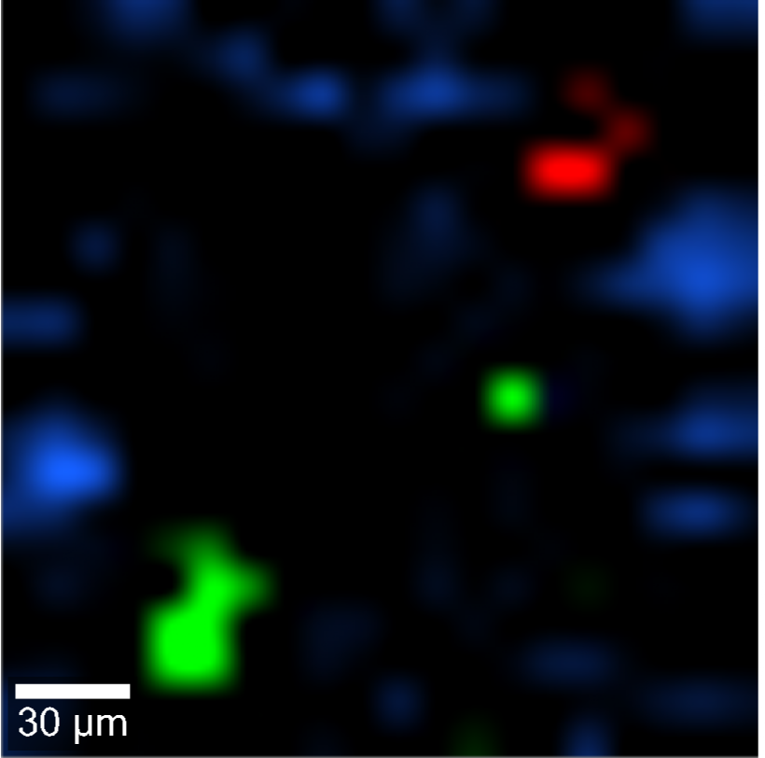
Olivine in Ca(OH)₂
Combine image
(a)
975.2
1087.0
(b)
863.2
820
2435.2
Figure1: Three major components are identified: (a) olivine (blue), calcium hydroxide (red), and ***** *(green). The mineral map in (b) shows the distribution of these minerals. Black is the background and blue is olivine, red Ca(OH)₂ and green (not sure)
1087.0 - Peak for calcium hydroxide
2435.2 – carbon material

Slide 7
